Slide 1
Discovery of a (possible) Higgs Boson at the LHC
Amitabh Lath
Rutgers, The State University of New Jersey
August 7, 2012

Slide 2
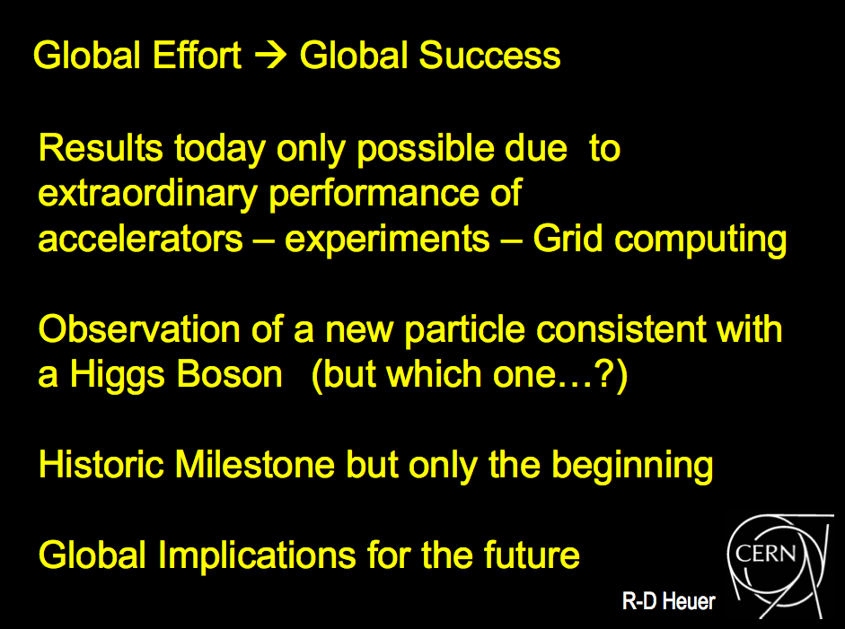
Statement by CERN DG on 7/4

Slide 3
Statement by CERN DG on 7/4
What’ he talking about?

Slide 4

Why do we need the Higgs Boson?
Isn’t this good enough?

Slide 5
Go back 100+ years . . .
Isn’t this good enough?

Slide 6
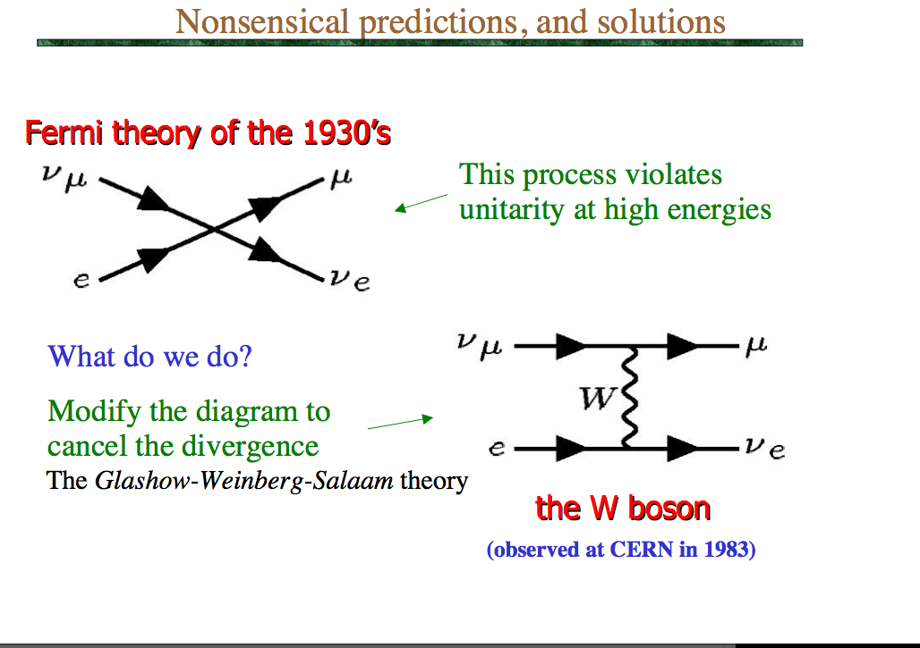

Slide 7
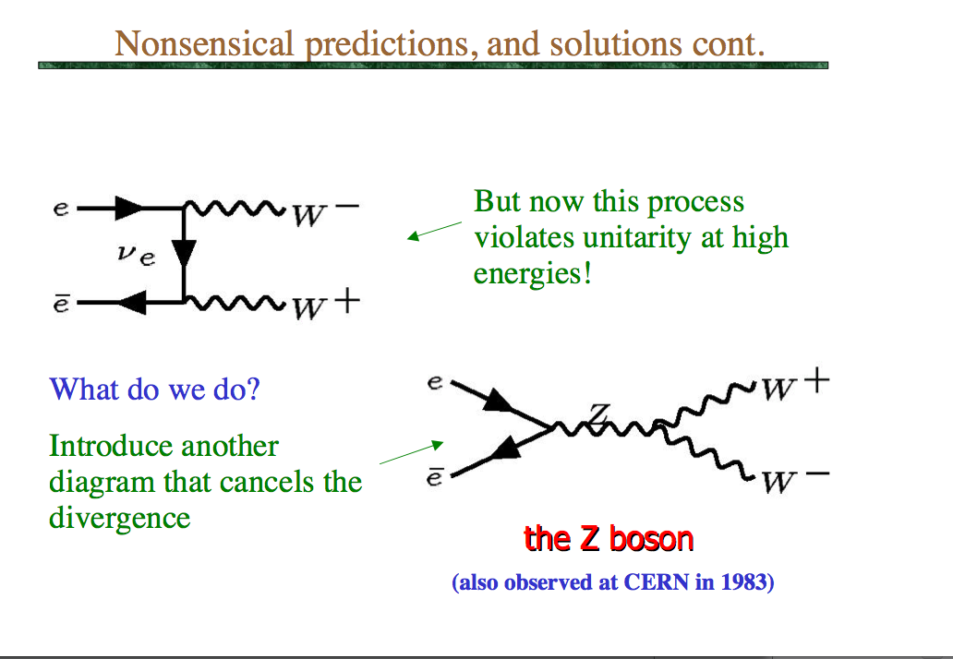

Slide 8
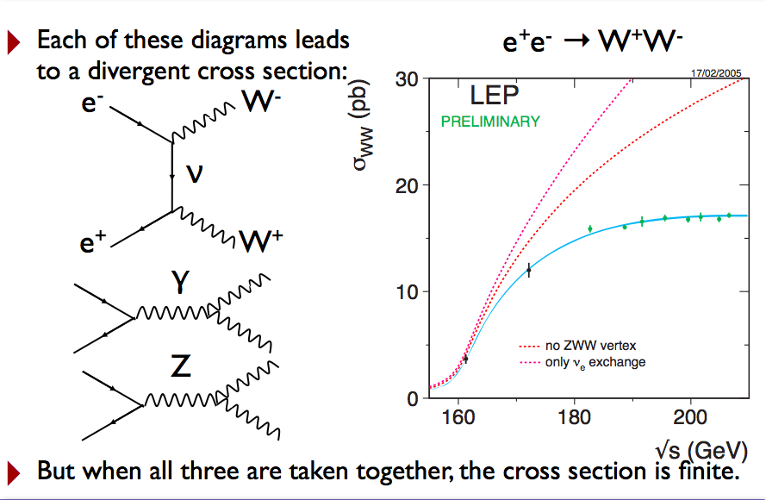

Slide 9
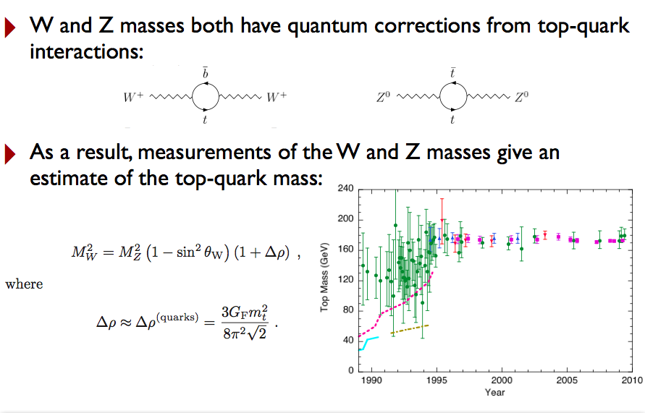

Slide 10
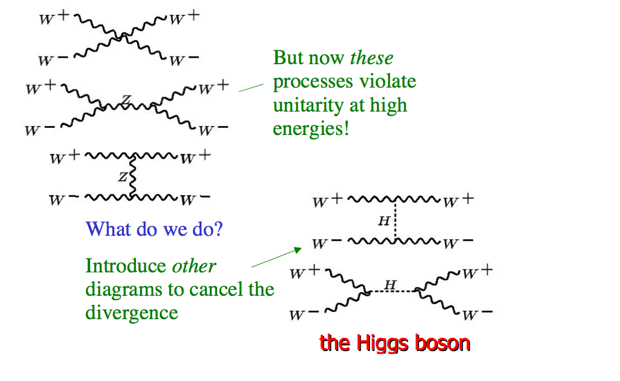

Slide 11
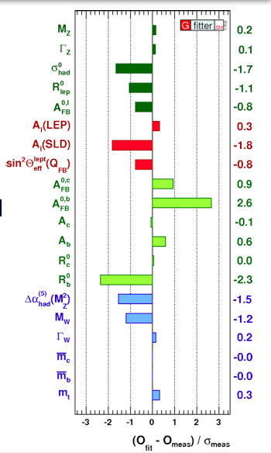
These are high precision Electro-Weak measurements.
They give you the top mass.
If you already know the top mass, then…

Slide 12
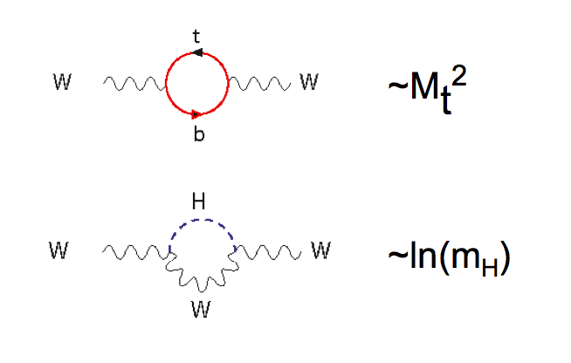
These are high precision Electro-Weak measurements.
They give you the top mass.
If you already know the top mass, then…

Slide 13
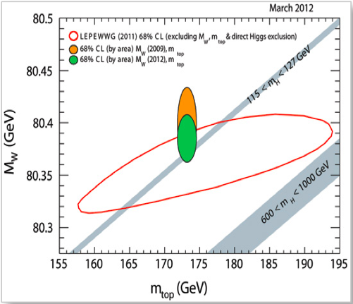

Slide 14
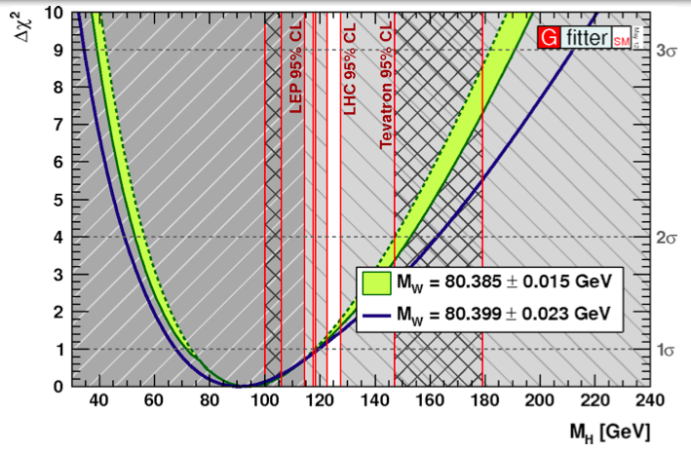
Precision Electro-Weak gives nice “window” on the Higgs Mass.

Slide 15
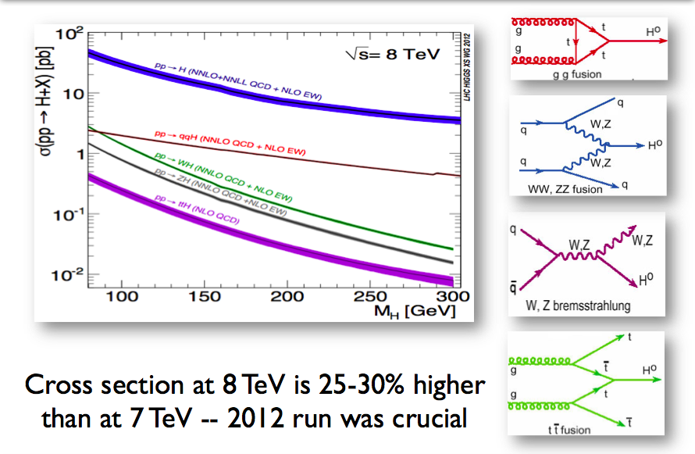
Higgs Production

Slide 16
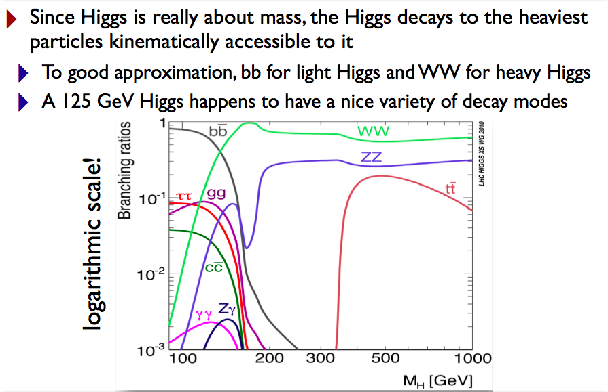
Higgs Decay

Slide 17
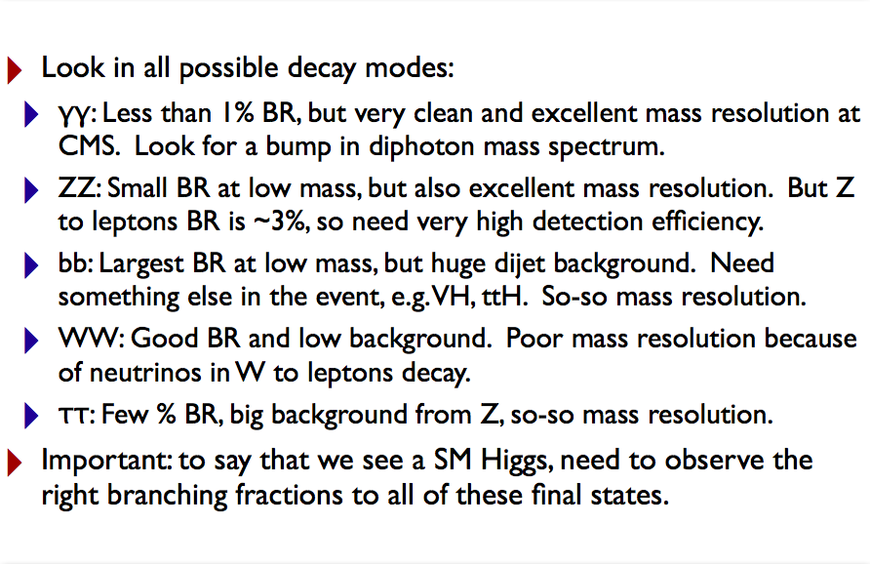
Higgs hunting strategy

Slide 18
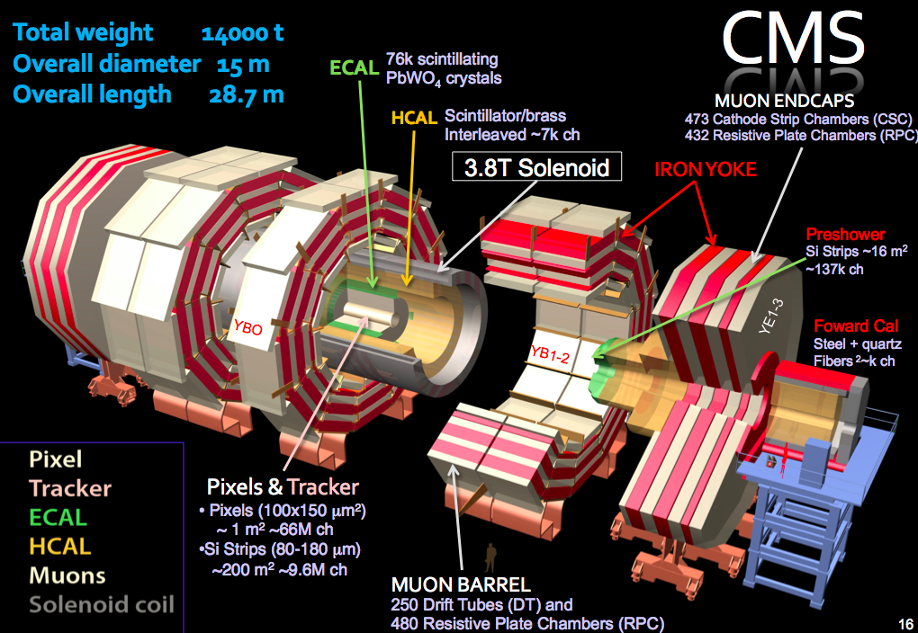

Slide 19
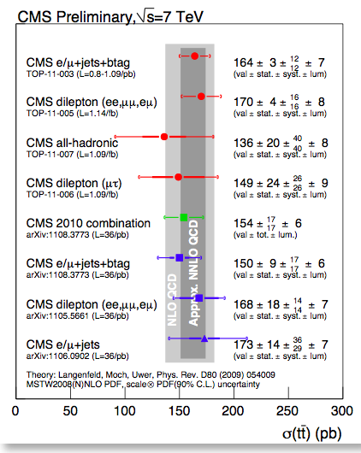
Can we measure Standard Model stuff well?

Slide 20
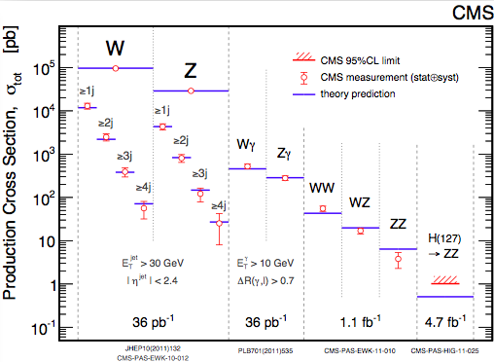
Can we measure Standard Model stuff well?

Slide 21
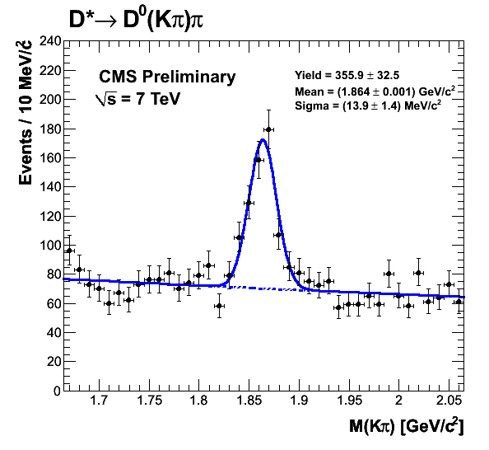
Can we measure Standard Model stuff well?

Slide 22
Can we measure Standard Model stuff well?

Slide 23
Can we measure Standard Model stuff well?
Standard Model in hand. Let’s proceed to Higgs

Slide 24
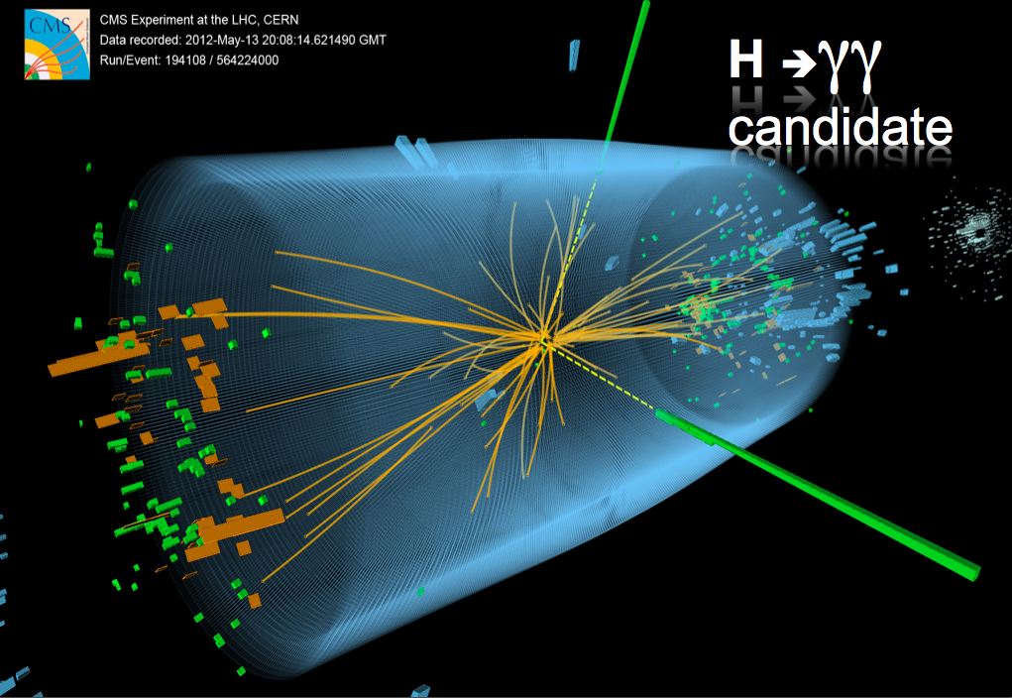

Slide 25
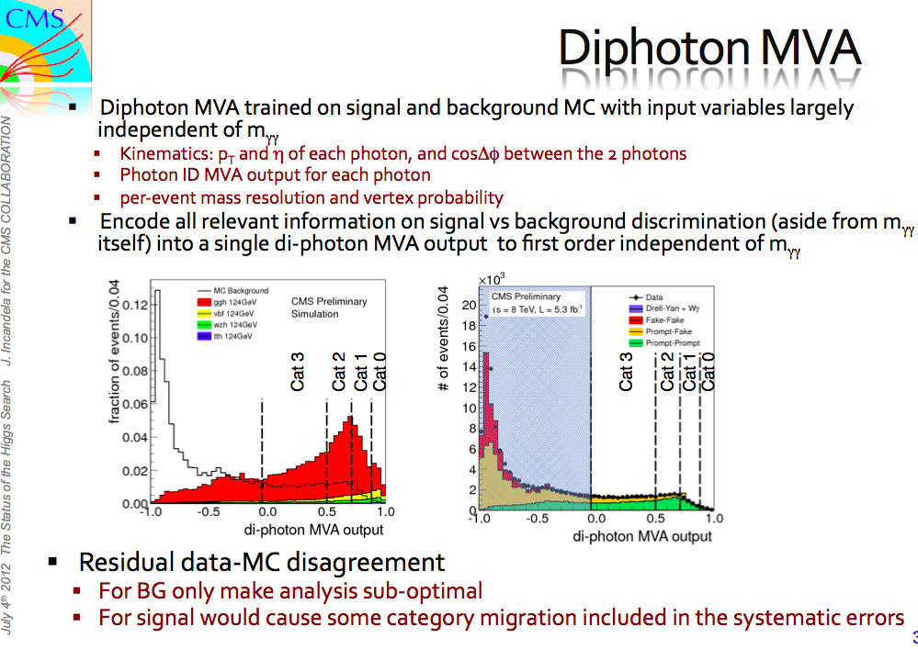

Slide 26
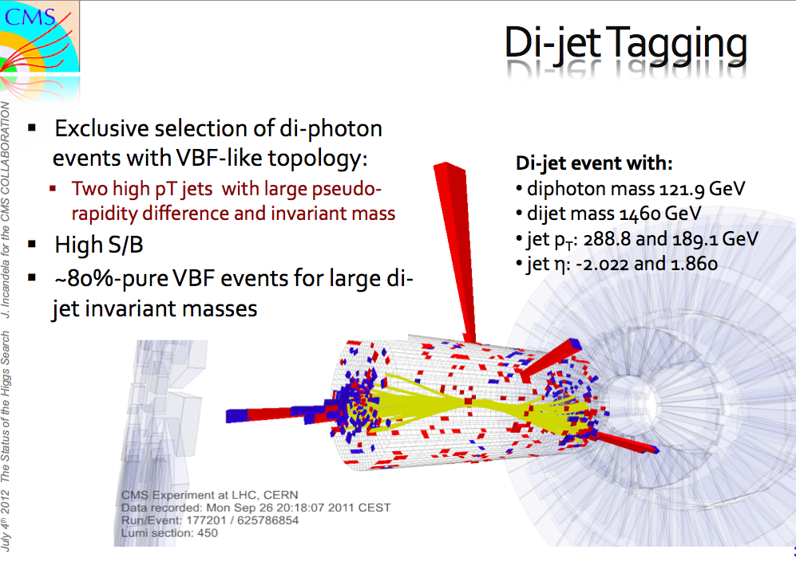

Slide 27
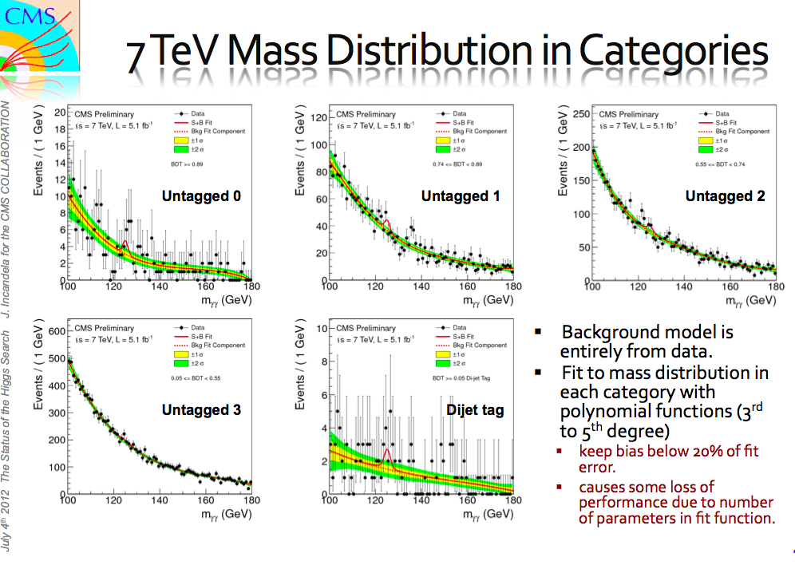

Slide 28
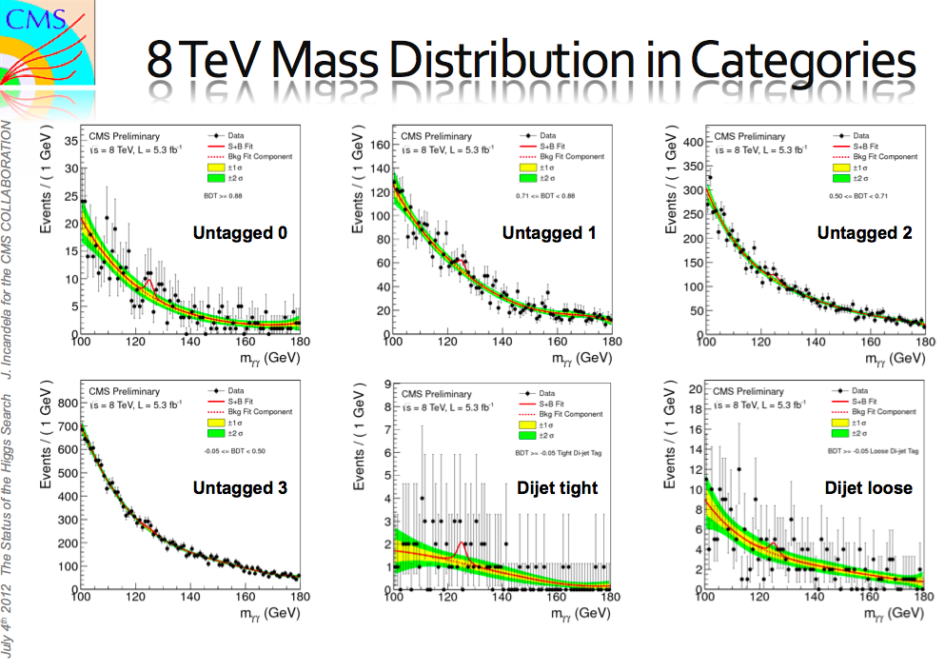

Slide 29
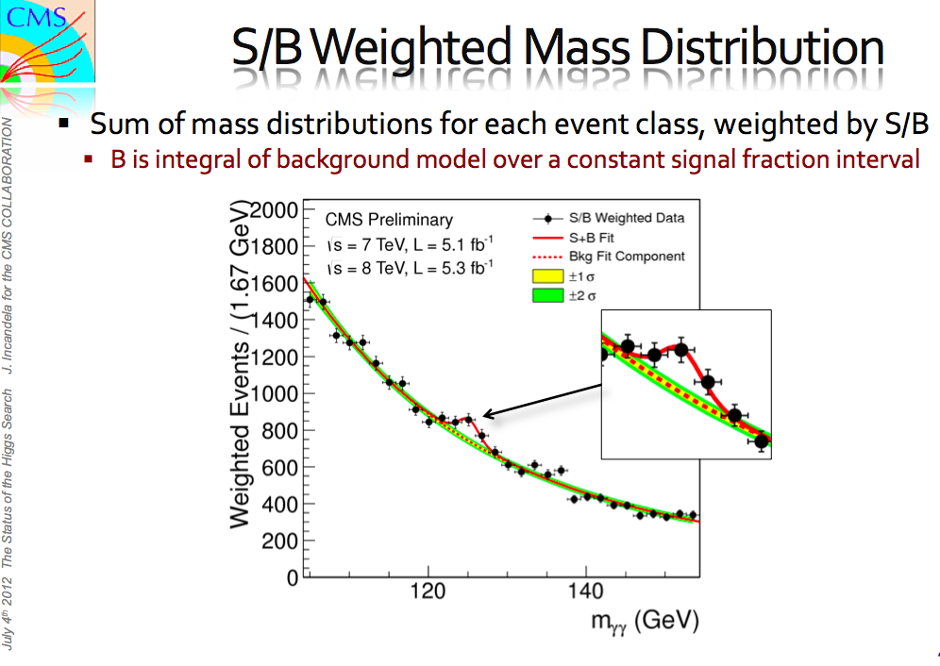

Slide 30
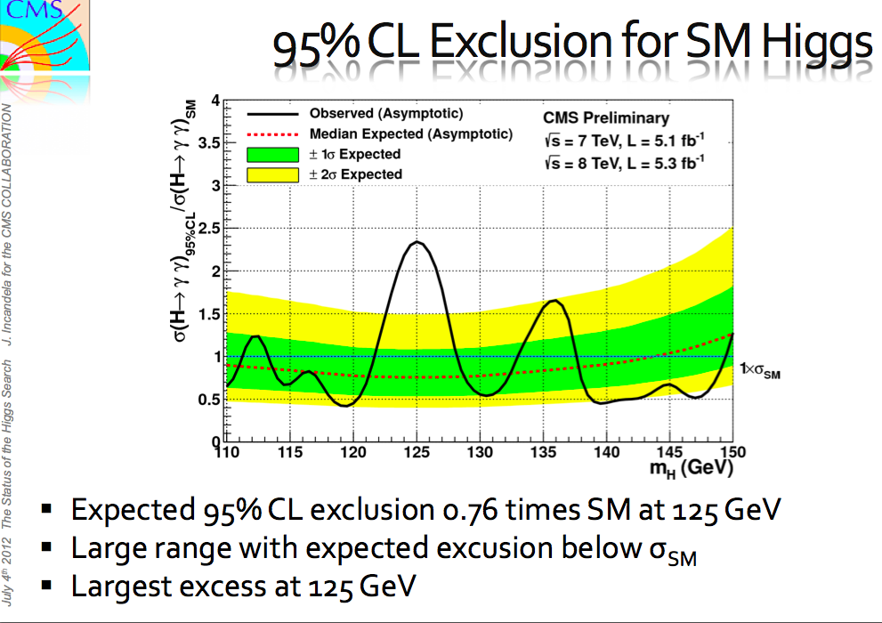

Slide 31
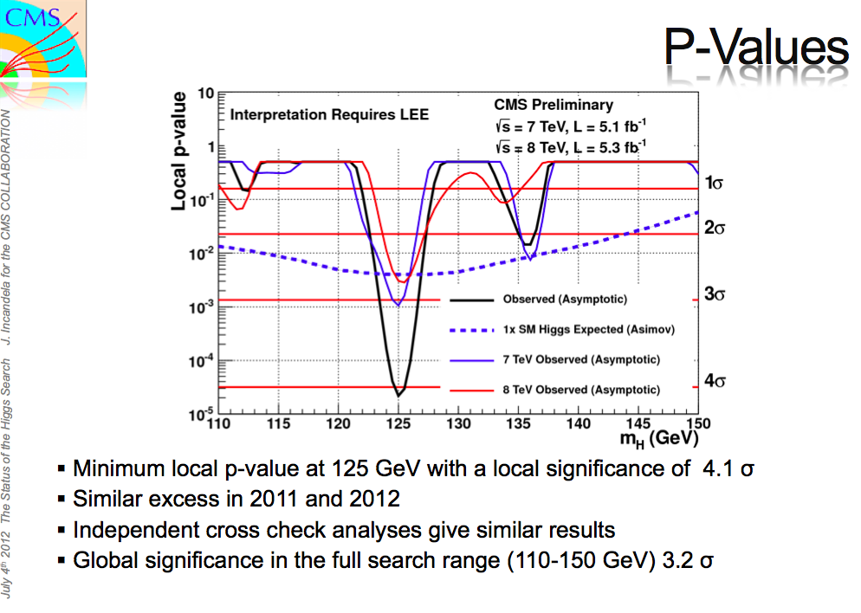

Slide 32
H → ZZ → 4leptons

Slide 33
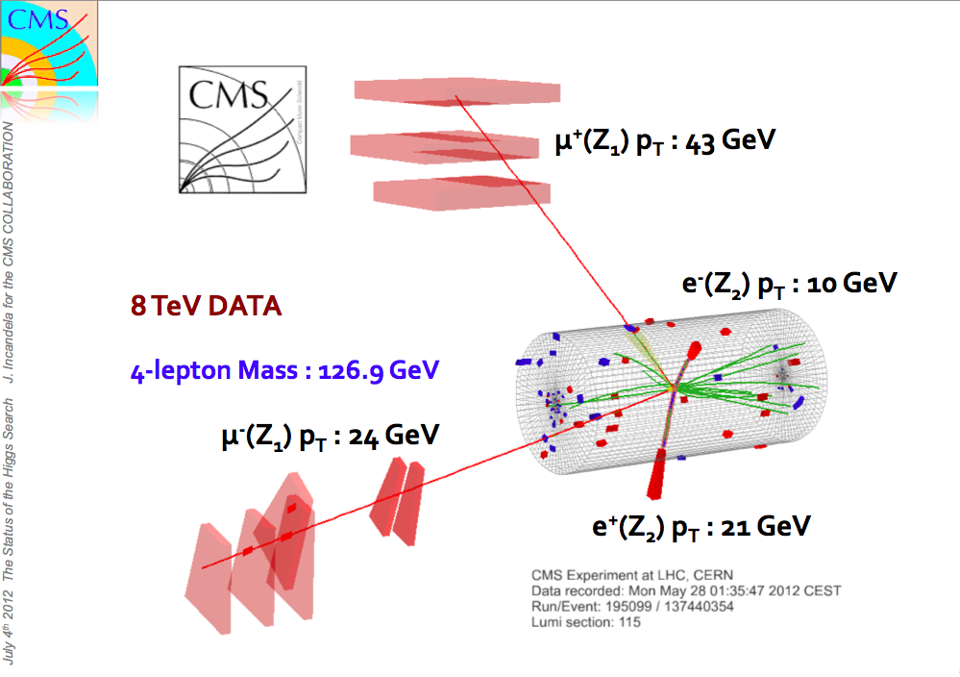

Slide 34
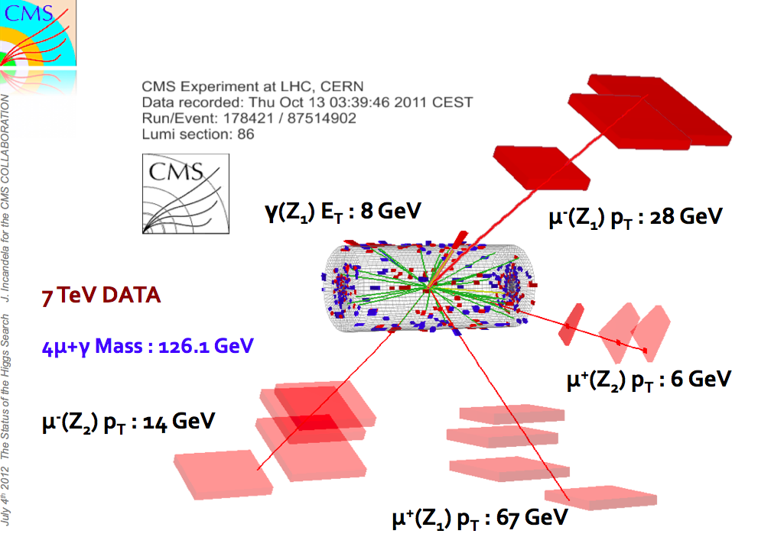

Slide 35
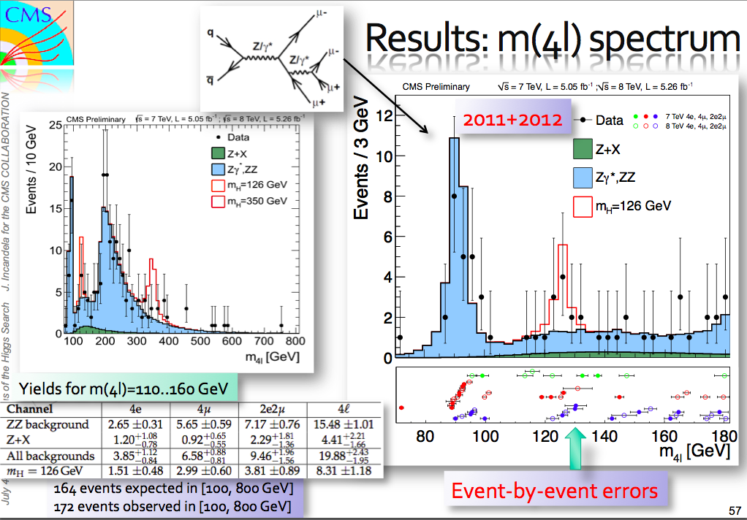

Slide 36
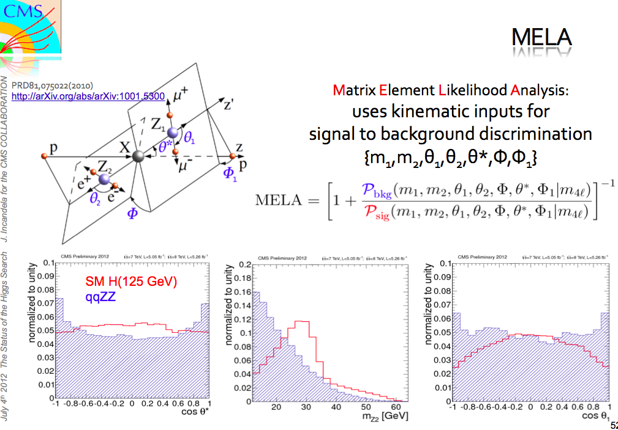

Slide 37
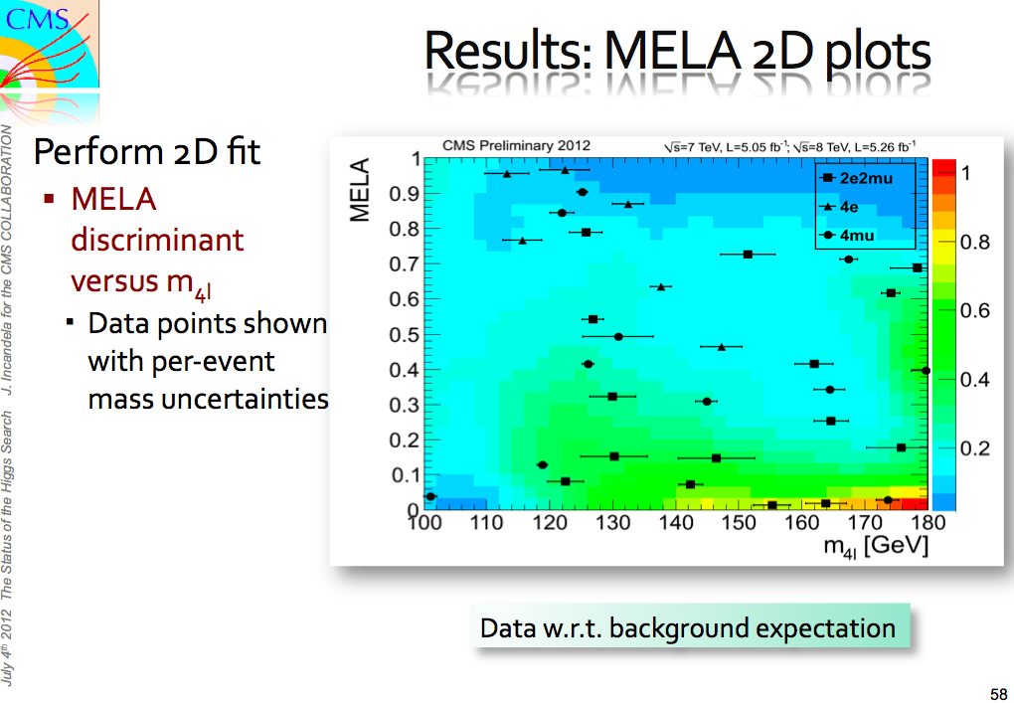

Slide 38
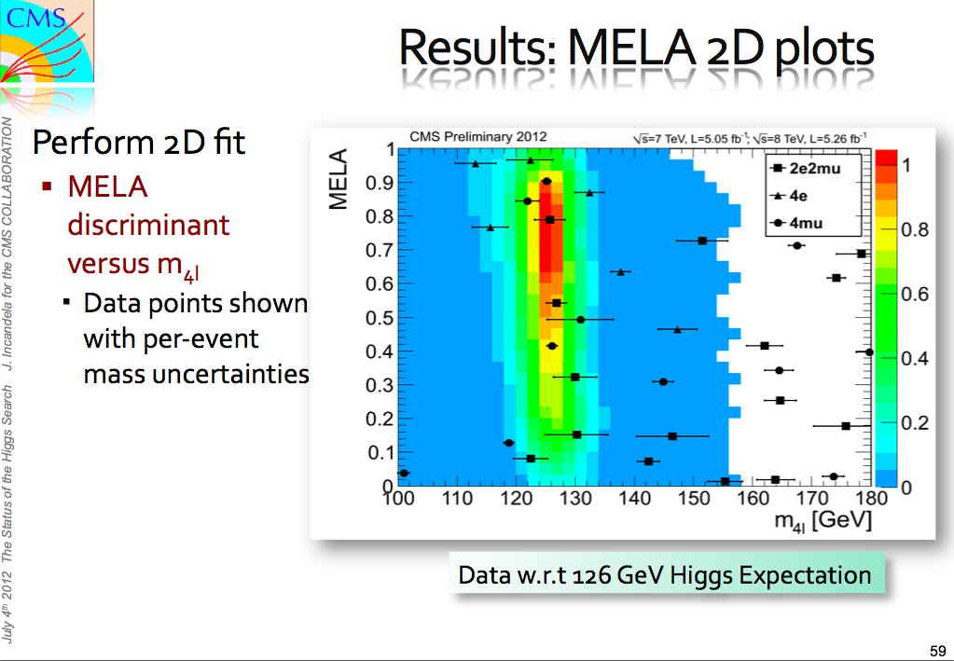

Slide 39
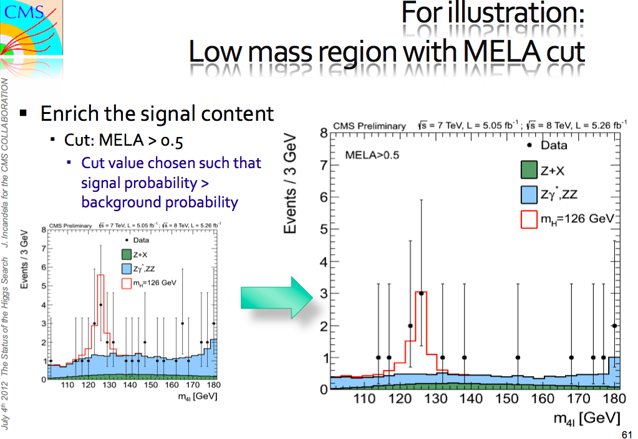

Slide 40
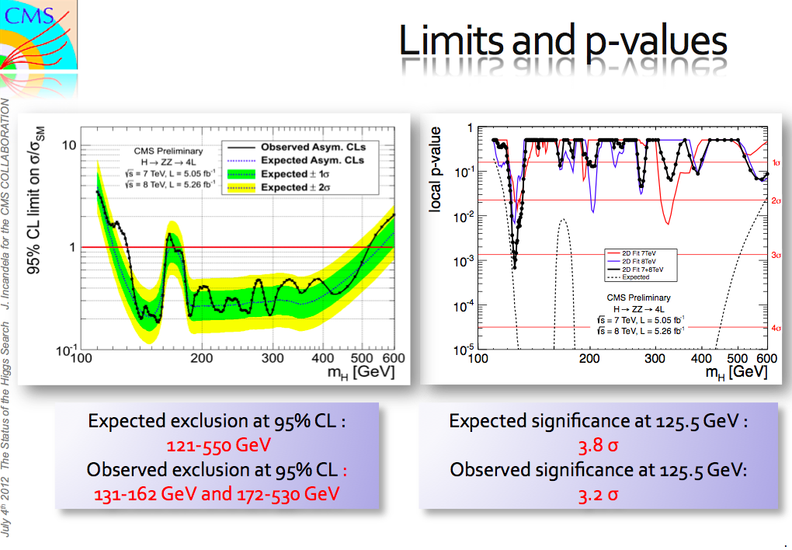

Slide 41
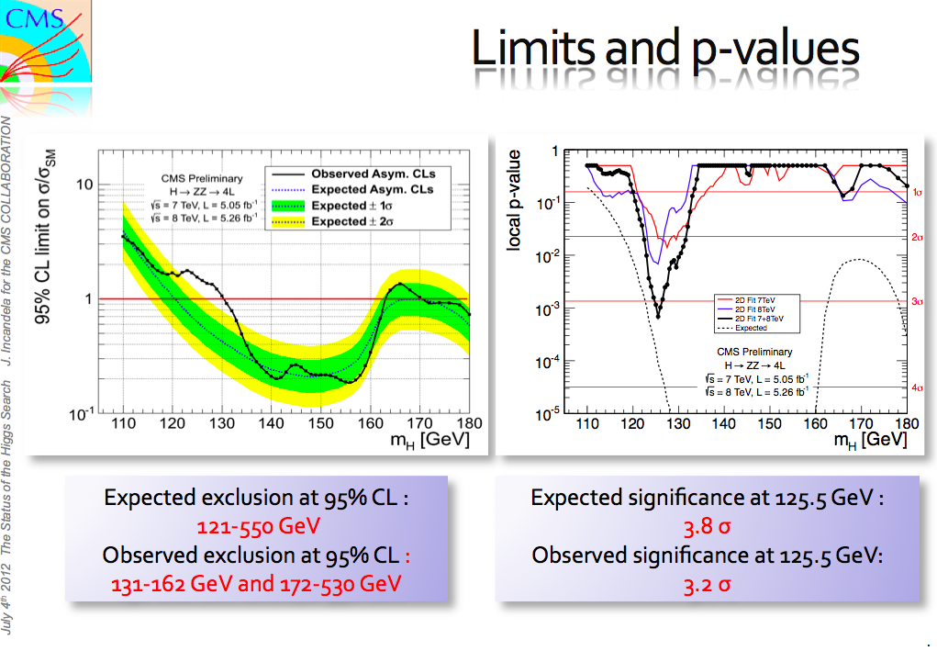

Slide 42
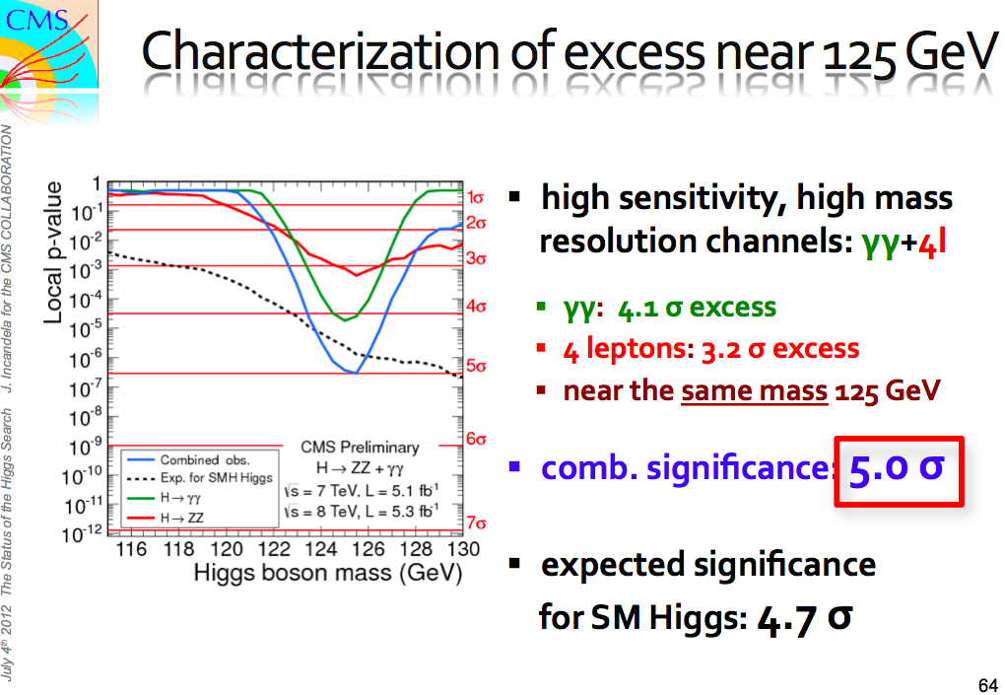

Slide 43
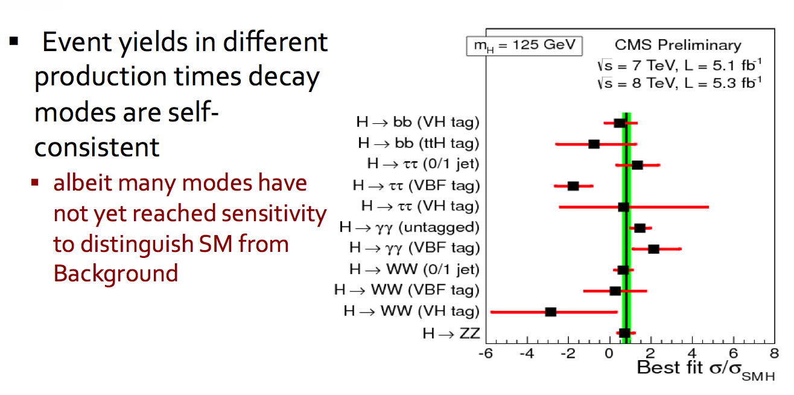
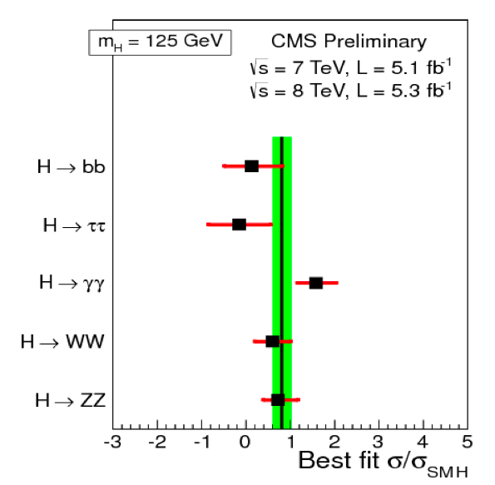
γγ, ZZ modes most sensitive

Slide 44
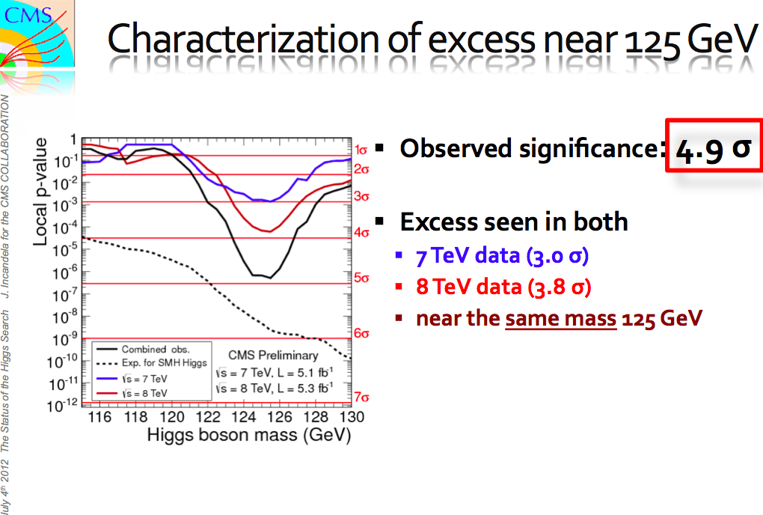

Slide 45
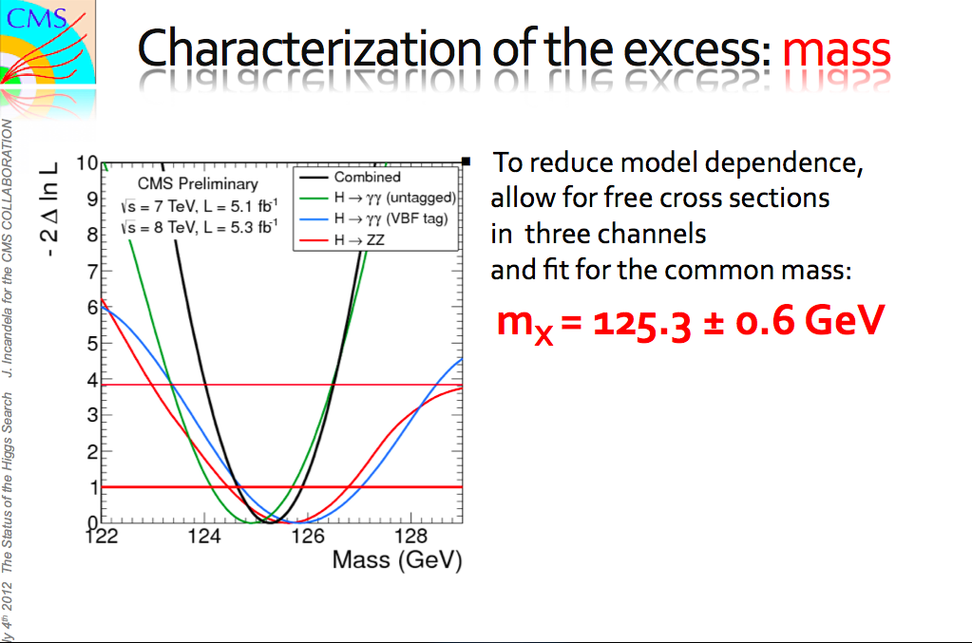

Slide 46
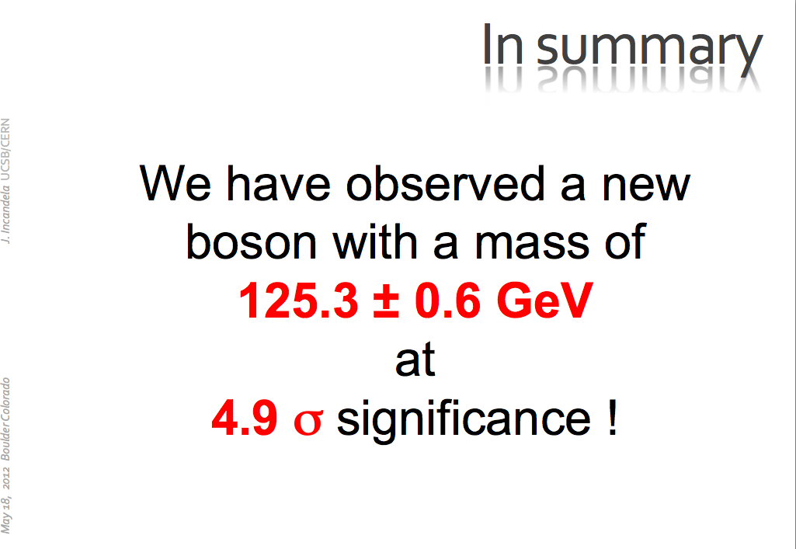

Slide 47
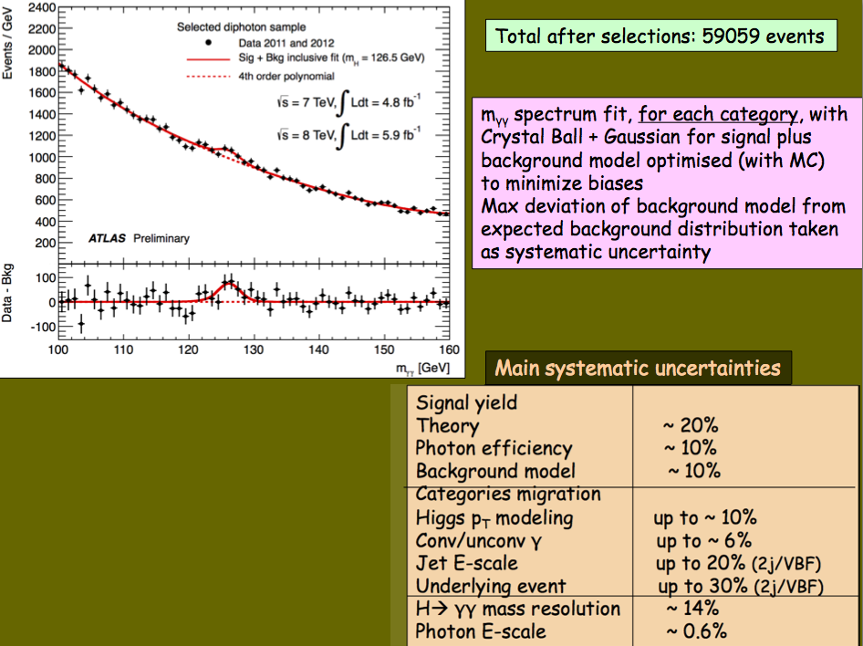

Slide 48
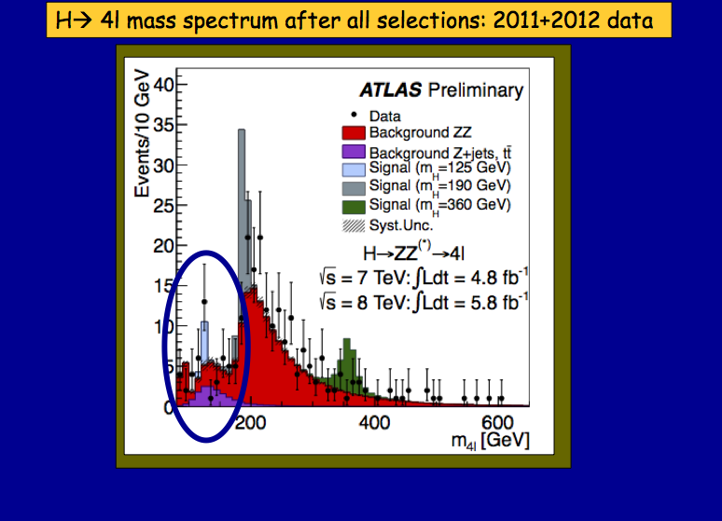

Slide 49
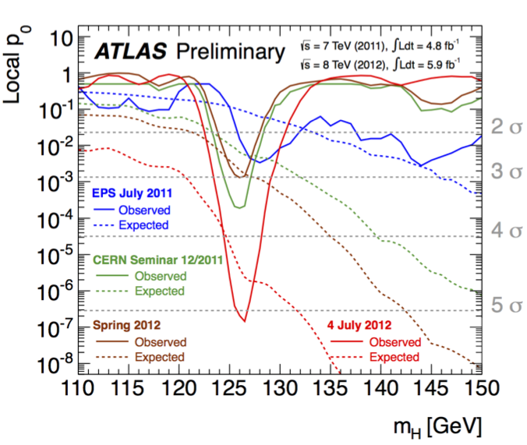

Slide 50
What Now?
We do not know what it is at 125-126 GeV/c^2.
It may be THE Higgs Boson, or
It may be A Higgs Boson
We need to measure its couplings to known particles.
It should couple to t, b, W, Z in predictable ways
We need to measure its spin (Higgs has 0 spin).
Note that cosmology needs a scalar (spin 0) field for inflation to work. But that’s another can of worms…

