Slide 1



Status of Spectral Problem in planar N=4 SYM
Rutgers University seminar
February,25, 2014
Vladimir Kazakov (ENS,Paris)
Collaborations with: Nikolay Gromov (King’s College, London)
Sebastien Leurent (Dijon University)
Dimytro Volin (Trinity College, Dublin)

Slide 2
Outline
Planar N=4 SYM is a superconformal 4D gauge theory with global symmetry PSU(2,2|4), integrable at any ‘t Hooft coupling. Solvable non-BPS! Summing genuine 4D Feynman diagrams for most important physical quantities: anomalous dimensions, correlation functions, Wilson loops, gluon scattering amplitudes…
Anomalous dimensions of local operators satisfy exact functional equations based on integrability. Confirmed by a host of straightforward calculations in weak coupling, strong coupling (using AdS/CFT) and BFKL limit.
Duality to 2D superstring ϭ-model on AdS₅xS⁵ allows to use standard framework of finite volume integrability: asymptotic S-matrix, TBA, Y-system and T-system (Hirota eq.) supplemented by analyticity w.r.t. spectral parameter
Wronskian solution of Hirota equation in terms of Baxter’s Q-functions, together with analyticity and certain inner symmetries of Q-system (full set of Q-functions related by Plücker relations) allow for the formulation of non-linear Riemann-Hilbert equations called quantum spectral curve (QSC)
We will mention some applications of QSC for operators in SL(2) sector
Notes:
2

Slide 3
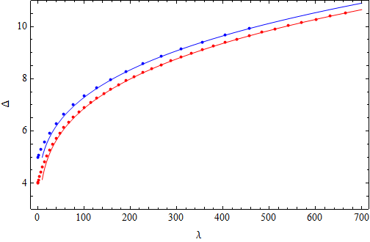
Example of « exact » numerics in SL(2) sector for twist L spin S operator
4 leading strong coupling terms were calculated for any S and L
Numerics from Y-system, TBA, FiNLIE, at any coupling:
- for Konishi operator
- and twist-3 operator
They perfectly reproduce the TBA/Y-system or FiNLIE numerics
Y-system numerics
Gromov,V.K.,Vieira
Frolov
Gromov,Valatka
Gubser, Klebanov, Polyakov
Gromov,Shenderovich,
Serban, Volin
Roiban, Tseytlin
Vallilo, Mazzucato
Gromov, Valatka
Frolov
Gromov, Valatka
AdS/CFT Y-system passes all known tests!
Notes:
3

Slide 4

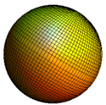
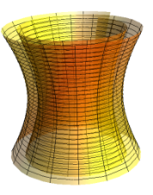





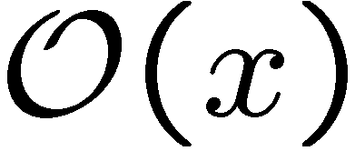
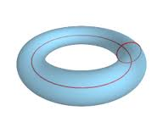
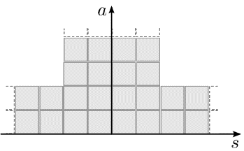
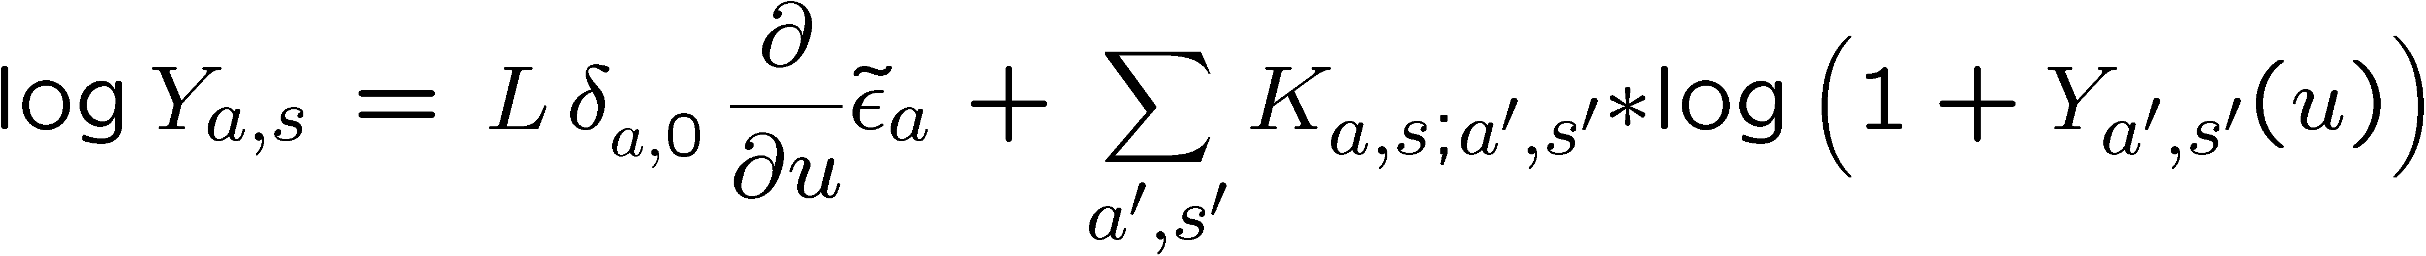
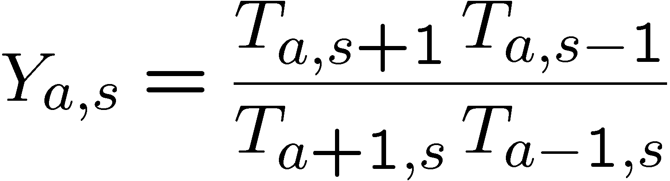
Integrability of AdS/CFT spectral problem
Minahan, Zarembo
Beisert,Kristjansen,Staudacher
Metsaev-Tseytlin
Bena, Roiban, Polchinski
V.K.,Marshakov, Minahan, Zarembo
Beisert, V.K.,Sakai, Zarembo
Weak coupling expansion for
SYM anomalous dimensions.
Perturbative integrability: Spin chain
Strong coupling from AdS-dual –
classical superstring sigma model
Classical integrability, algebraic curve
Beisert,Eden, Staudacher
Janik, beisert
S-matrix
Asymptotic Bethe ansatz
Gromov, Kazakov, Vieira
Bombardelli,Fioravanti,Tateo
Gromov,V.K.,Kozak,Vieira
Arutyunov,Frolov
Y-system + analyticity
Thermodynamic
Bethe ansatz (exact!)
PSU(2,2|4)
Cavaglia,Fioravanti,Tateo
Hegedus,Balog
Gromov, V.K., Tsuboi,
Gromov, V.K., Leurent, Tsuboi
Wronskian solution of T-system via Baxter’s Q-functions
Q-system + analyticity :
Finite system of integral non-linear equations (FiNLIE)
Gromov, V.K., Leurent, Volin
Finite matrix Riemann-Hilbert eqs.
for quantum spectral curve (P-µ)
Gromov, V.K., Leurent, Volin

Slide 5



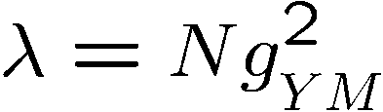
Dilatation operator in SYM perturbation theory
Dilatation operator from
point-splitting and renormalization
Conformal dimensions are eigenvalues of
dilatation operator
Can be computed from perturbation theory in

Slide 6
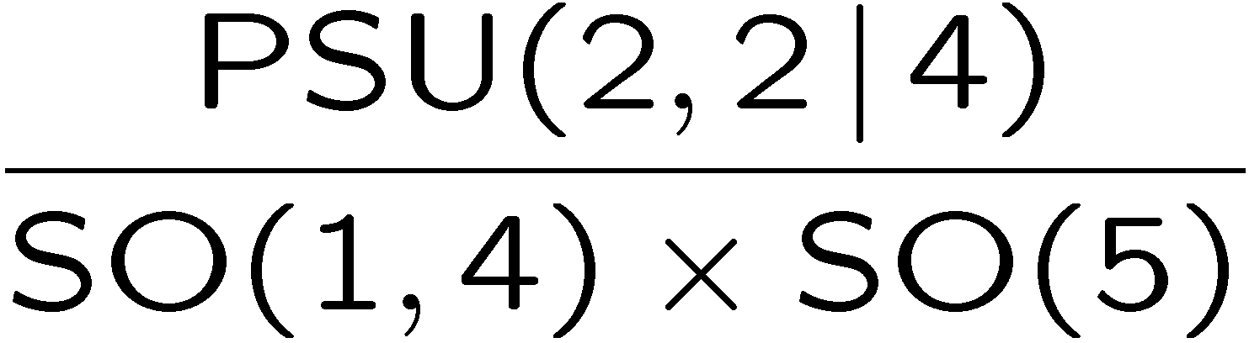




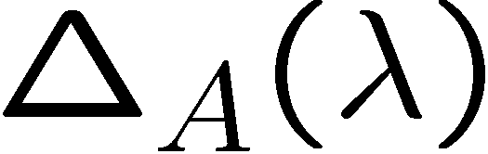
SYM is dual to supersting σ-model on AdS5 ×S⁵
Maldacena
Gubser, Polyakov, Klebasnov
Witten
Super-conformal N=4 SYM symmetry PSU(2,2|4) → isometry of string target space
2D ϭ-model
on a coset
fermions
target space
AdS time
world sheet
Metsaev-Tseytlin action
Dimension of YM operator
Energy of a string state

Slide 7

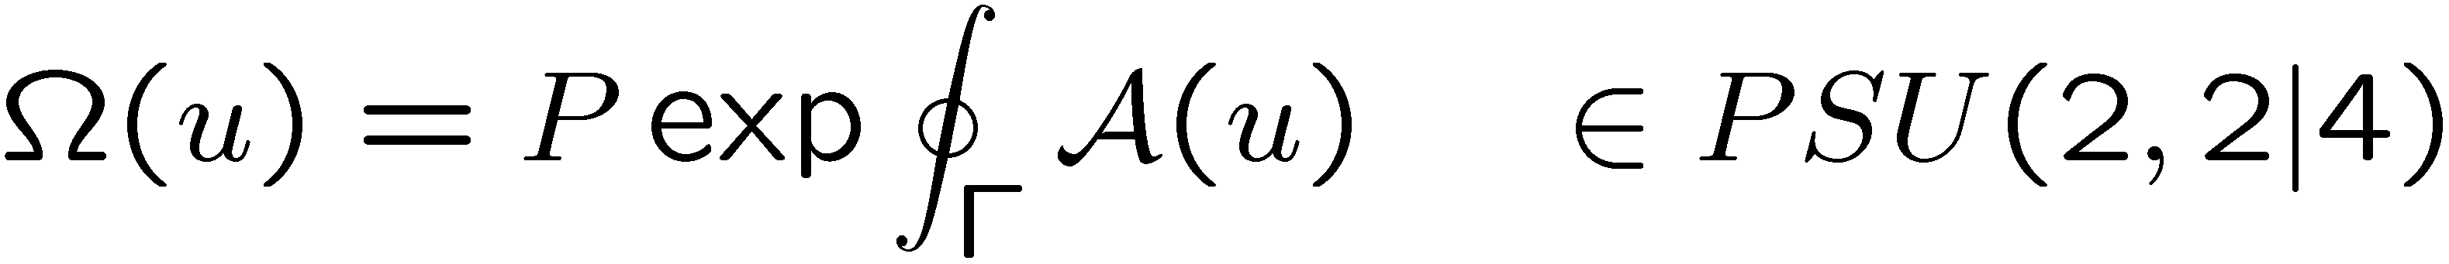
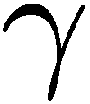
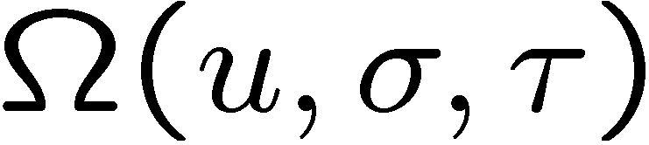


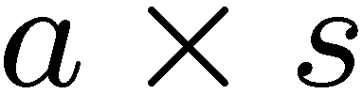
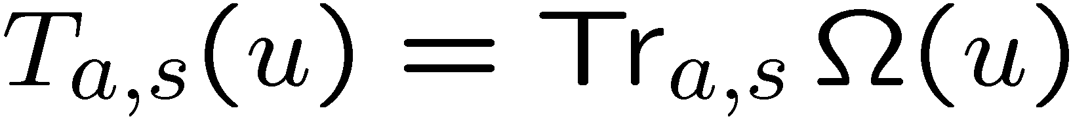
Classical integrability of superstring on AdS₅×S⁵
String equations of motion and constraints can be recast
into flat connection condition
Mikhailov,Zakharov
Bena,Roiban,Polchinski
for Lax connection - double valued w.r.t. spectral parameter
Monodromy matrix
encodes infinitely many conservation lows
world sheet
Algebraic curve for quasi-momenta
Its,Matweev,Dubrovin,Novikov,Krichever
V.K.,Marshakov,Minahan,Zarembo
Beisert,V.K.,Sakai,Zarembo
psu(2,2|4) character of in irreps for rectangular Young tableaux:
Gromov,V.K.,Tsuboi
a
Is a classical analog of quantum T-functions
s
Notes:
7

Slide 8





(Super-)group theoretical origins of Y- and T-systems
A curious property of gl(N|M) representations with rectangular Young tableaux:
=
+
a-1
a
a+1
s
s
s-1
s+1
For characters – simplified Hirota eq.:
a
Kwon
Cheng,Lam,Zhang
Gromov, V.K., Tsuboi
Gunaydin, Volin
s
Full quantum Hirota equation: extra variable – spectral parameter
“Classical limit”: eq. for characters as functions of classical monodromy
Can be solved in terms of Baxter’s Q functions: Q-system
Gromov,V.K., LeurentTsuboi

Slide 9
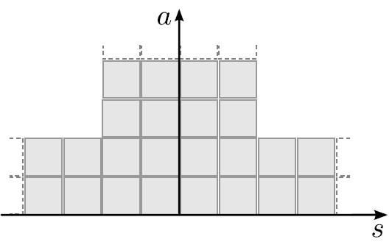

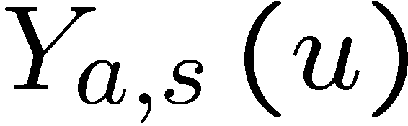
Y-system and Hirota eq.: discrete integrable dynamics
Case of AdS/CFT: gl(2,2|4) superconformal group
Hirota equation is a discrete integrable system
It can be solved in terms of Wronskians (det’s) of Baxter’s Q-functions
Example: exact solution for right band of T-hook via two functions:
Complete solution described by Q-system – full set of 2^{K+M} Q-functions
Q-system imposes strong conditions on analyticity of Q-functions

Slide 10

Krichever,Lipan, Wiegmann,Zabrodin
Gromov, Vieira
V.K., Leurent, Volin.
Q-system
Basis: N-vector of single-index Q-functions
Other N-vectors obtained by shifts:
One-form:
Notations:
-form encodes all Q-functions with indices:
Multi-index Q-function: coefficient of
Example for gl(2) :
Plücker’s QQ-relations:
Any Q-function can be expressed through N basic ones

Slide 11
Tsuboi
Gromov,V.K., Leurent, Tsuboi
V.K.,Leurent,Volin
(M|K)-graded Q-system
Notations in terms of sets of indices:
Split M+N indices as
Grading = re-labeling of F-indices (subset → complimentary subset of F)
Gauge:
Examples for (4|4):
Graded forms:
Same QQ-relations involving 2 indices of same grading.
New type of QQ-relations involwing 2 indices of opposite grading:

Slide 12
Graded (non)determinant relations
All Q-functions expressed by determinants of double-indexed
and 8 basic single indexed
Examples:
Important double-index Q-function cannot be expressed through
the basic single-index functions by determinants.
Instead we have to solve a QQ relation

Slide 13
Hodge (*) duality transformation
Hodge duality is a simple relabeling:
Example for (4|4):
Satisfy the same QQ-relations if we impose:
From QQ-relations: plays the role of “metric” relating indices in different gradings

Slide 14
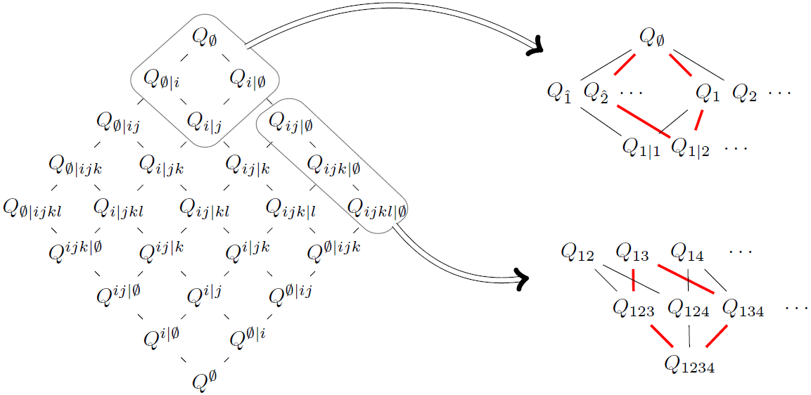
Hasse diagram of (4|4) and QQ-relations
A projection of the Hasse diagram (left): each node corresponds to Q-functions
having the same number of bosonic and fermionic indices
A more precise picture (right) of some small portions of this diagram illustrates the
``facets'' (red) corresponding to particular QQ-relations

Slide 15
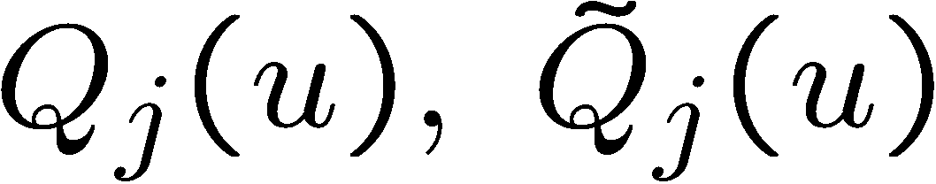
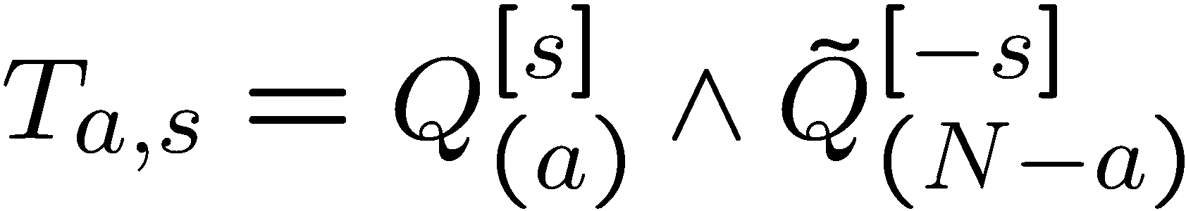
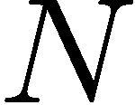
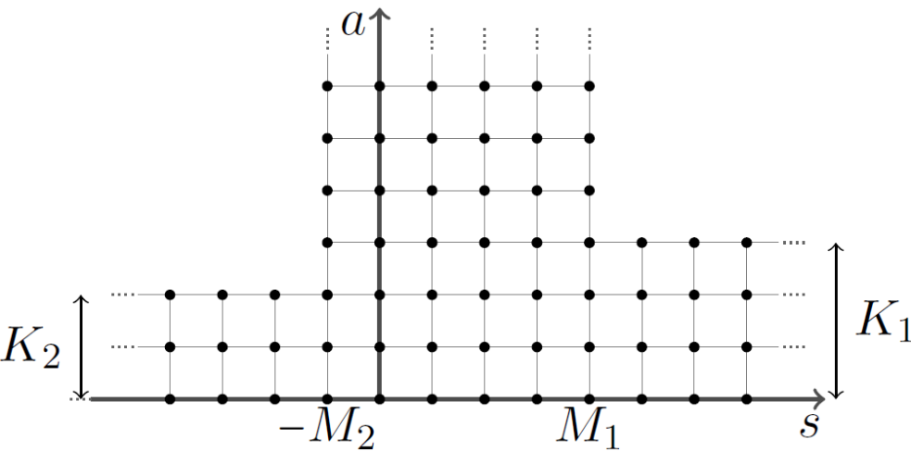
Wronskian solution of Hirota eq.
Example: solution of Hirota equation in a band of width N in terms of
differential forms with 2N coefficient functions
Solution combines dynamics of gl(N) representations and quantum fusion:
Krichever,Lipan, Wiegmann,Zabrodin
a
For su(N) spin chain (half-strip) we impose:
s
Solution of Hirota eq. for (K₁,K₂ | M₁+M₂) T-hook
Tsuboi
V.K.,Leurent,Volin

Slide 16
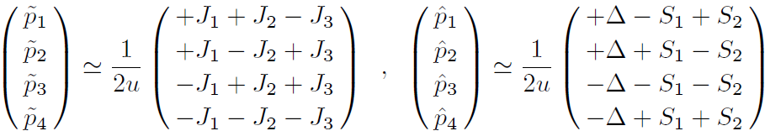
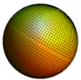

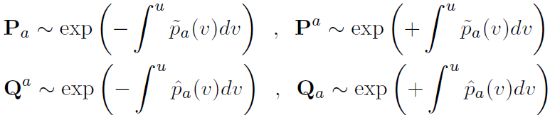
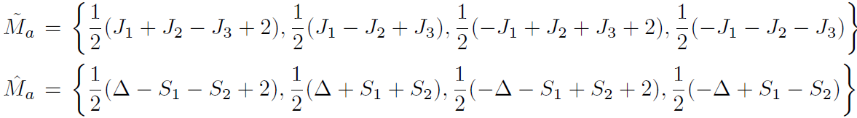
AdS/CFT quantum spectral curve (Pµ-system)
Gromov, V.K., Leurent, Volin 2013
Inspiration from quasiclassics: large u asymptotics of quasimomenta defined by
Cartan charges of PSU(2,2|4):
Quantum analogues – single index Q-functions:
also with only one cut on the defining sheet!
From quasiclassical asymptotics of quasi-momenta:
Asymptotics of all other Q-functions follow from QQ-relations.

Slide 17


H*-symmetry between upper- and lower-analytic Q’s
Structure of cuts of P-functions:
We can “flip” all short cuts to long
ones going through the short cuts
from above or from below. It gives
the upper or lower-analytic P’s.
Q-system allows to choose all Q-functions upper-analytic or all lower-analytic
Both representations should be physically equivalent → related by symmetries.
It is a combination of matrix and Hodge transformation, called H* (checked from TBA!)
Similarly:
(true only for 4×4
antisym. matrices!)
Back to short cuts: we get the most important relation of Pµ-system:

Slide 18

Equations on µ
From and its analytic continuation trough the cut
we conclude that
Similar eq. from QQ-relations
We interpret µ as a linear combination of solutions of the last equation
with short cuts, with i-periodic coefficients packed into antisymmetric ω-matrix
The Riemann-Hilbert equation on µ takes the form
Using and pseudo-periodicity
we rewrite it as a finite difference equation
Similar Riemann-Hilbert equations can be written on and ω (long cuts)

Slide 19
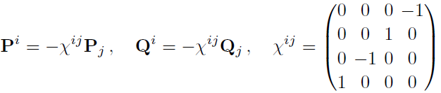


SL(2) sector: twist L operators
“Left-Right symmetric” case:
Gromov, V.K., Leurent, Volin 2013
Spectral Riemann-Hilbert equations (short cuts):
where is the analytic continuation of through the cut:
Cut structure on defining sheet and asymptotics at

Slide 20
Example: SL(2) sector at one loop from P-µ
Plugging these asymptotics into Pµ eq. we get for coefficients of asymptotics
In weak coupling, since we know that
we can put and system of 5 equations on
reduces to one 2-nd order difference equation
We can argue that
From the absence of poles in P’s at
which brings us to the standard Baxter equation for SL(2) Heisenberg spin chain!
where

Slide 21
One loop anomalous dimensions for SL(2)
To find anomalous dimensions demands the solution of P-µ system to the next order in as seen from asymptotics
In the regime we split into regular and singular parts
Solving Baxter eq. for singular part in this regime we find:
Using the asymptotics of Euler’s and comparing with the large u asymptotics for we recover standard formula
Using mirror periodicity we recover the trace cyclicity property
Note that these formulas follow from P-µ system and not from a particular form of Hamiltonian, as in standard Heisenberg spin chain!

Slide 22
Perturbative Konishi: integrability versus Feynman graphs
Integrability allows to sum exactly enormous numbers of Feynman diagrams of N=4 SYM
Bajnok,Janik
Leurent,Serban,Volin
Bajnok,Janik,Lukowski
Lukowski,Rej,
Velizhanin,Orlova
Leurent, Volin
Leurent, Volin
(8 loops from FiNLIE)
Volin
(9-loops from spectral curve)
Confirmed up to 5 loops by direct graph calculus (6 loops promised)
Fiamberti,Santambrogio,Sieg,Zanon
Velizhanin
Eden,Heslop,Korchemsky,Smirnov,Sokatchev

Slide 23
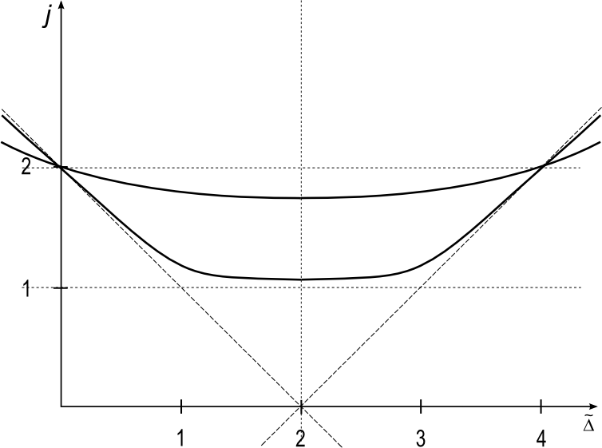
Analytic continuation w.r.t. spin and BFKL from P-µ
Qualitative dependence of anomalous
dimension of continuous spin S
S
0
The problem is to reproduce it
from the P-µ system
numerically exactly and study
the weak and strong coupling,
as well as the BFKL approximation
-1
-2 -1 0 1 2 Δ
We managed to find the one loop solution of SL(2) Baxter equation:
Janik
Gromov, V.K
Anom. dim:
BFKL is a double scaling limit:
which leads to

Slide 24
Conclusions
We proposed a system of matrix Riemann-Hilbert equations for the exact spectrum of anomalous dimensions of planar N=4 SYM theory in 4D. This P-µ system defines the full quantum spectral curve of AdS5 ×S⁵ duality
Very efficient for numerics and for calculations in various approximations
Works for Wilson loops and quark-antiquark potential in N=4 SYM
Exact slope and curvature functions calculated
Future directions
Simplar equations in Gluon amlitudes, correlators, Wilson loops, 1/N – expansion ?
BFKL (Regge limit) from P-µ -system? (in progress)
Strong coupling expansion from P-µ -system?
Same method of Riemann-Hilbert equations and Q-system for other sigma models ?
Finite size bootstrap for 2D sigma models without S-matrix and TBA ?
Deep reasons for integrability of planar N=4 SYM ?
Correa, Maldacena, Sever
Drucker
Gromov, Sever
Gromov, Kazakov, Leurent, Volin
Basso
Gromov, Levkovich-Maslyuk, Sizov, Valatka

Slide 25
END

