Slide 1


On Spacetime
Entanglement
(Bianchi , Smolkin, Pourhasan)
(arXiv:1212.5183; arXiv:1304.2030)

Slide 2
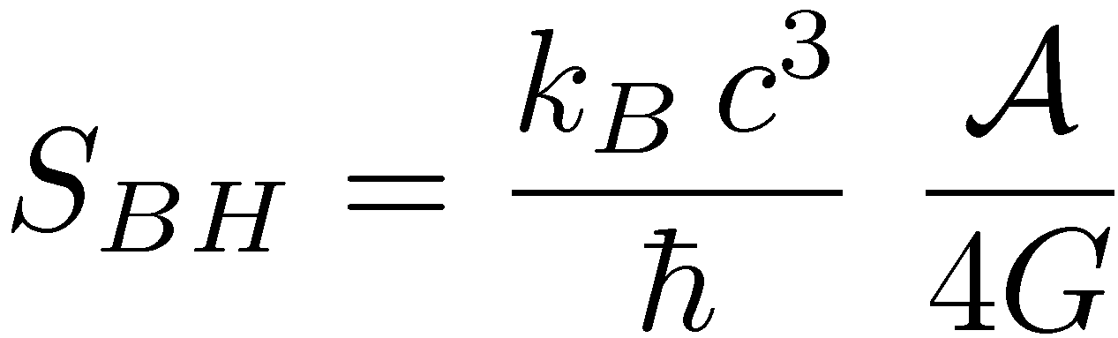
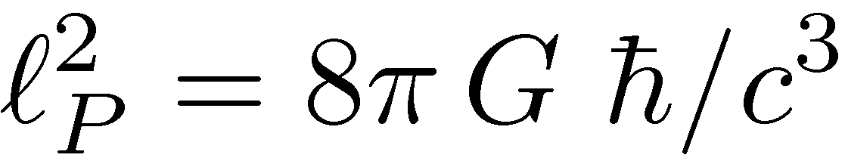
Black Hole Entropy:
Bekenstein and Hawking: event horizons have entropy!
thermodynamics
relativity
geometry
quantum
gravity
gravity
quantum
extends to de Sitter horizons and Rindler horizons
window into quantum gravity?!?
quantum gravity provides a fundamental scale

Slide 3
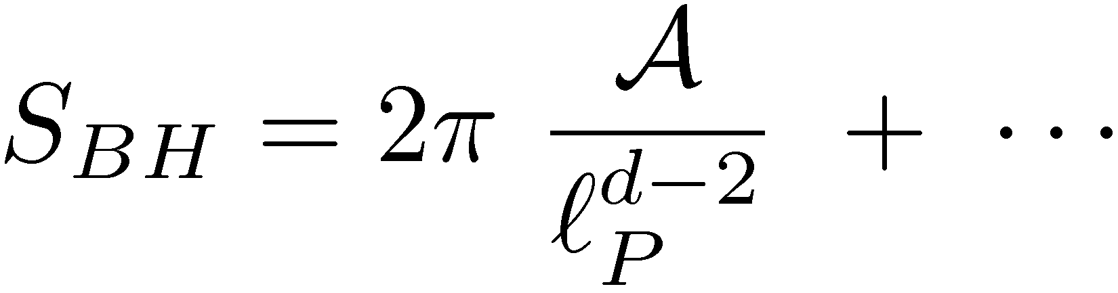
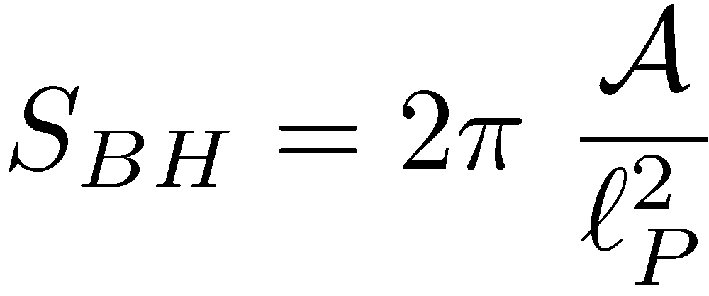
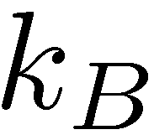
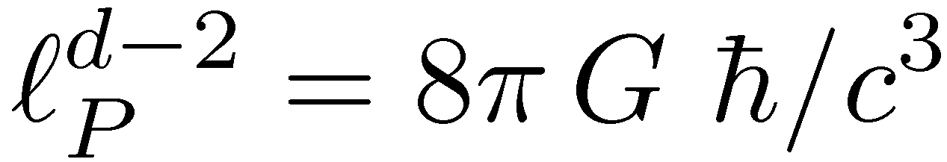
Black Hole Entropy:
Bekenstein and Hawking: event horizons have entropy!
extends to de Sitter horizons and Rindler horizons
window into quantum gravity?!?
quantum gravity provides a fundamental scale

Slide 4
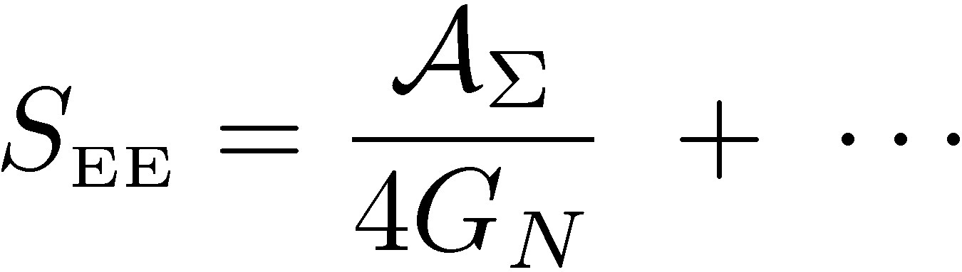

Proposal: Geometric Entropy
in a theory of quantum gravity, for any sufficiently large region
with a smooth boundary in a smooth background (eg, flat space),
there is an entanglement entropy which takes the form:
B
A
in QG, short-range quantum entanglement points towards how
microscopic dof create a macroscopic spacetime geometry
(cf. van Raamsdonk’s “Building up spacetime with quantum entanglement”)

Slide 5

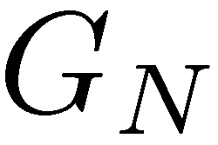
Proposal: Geometric Entropy
(Bianchi & Myers)
in a theory of quantum gravity, for any sufficiently large region
with a smooth boundary in a smooth background (eg, flat space),
there is an entanglement entropy which takes the form:
evidence comes from several directions:
holographic in AdS/CFT correspondence
QFT renormalization of
induced gravity, eg, Randall-Sundrum 2 model
Jacobson’s “thermal origin” of gravity
spin-foam approach to quantum gravity

Slide 6

Outline:
Introduction and Concluding remarks
  Entanglement Entropy 1:
  ► Basic Definitions
  ► Holographic Entanglement Entropy
Entanglement Entropy 2:
Entanglement Entropy 3:
Entanglement Hamiltonian and Generalizing S_{BH}
5. Randall-Sundrum calculations:
Induced Gravity and Holography
6. Conclusions & Outlook

Slide 7
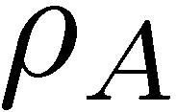

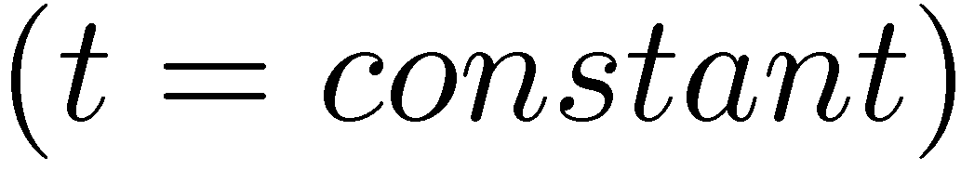
Entanglement Entropy
general tool; divide quantum system into two parts and use
entropy as measure of correlations between subsystems
in QFT, typically introduce a (smooth) boundary or entangling
surface which divides the space into two separate regions
trace over degrees of freedom in “outside” region
remaining dof are described by a density matrix
calculate von Neumann entropy:
B
A
Notes:
Area law reminds us of black hole entropy (sorkin, srednicki)
Condensed matter physics – used as a diagnostic to characterize quantum phases
Of matter/ also popular in quantum information theory

Slide 8


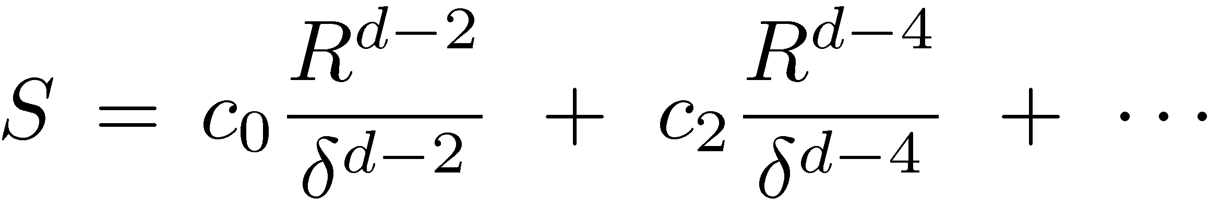
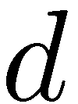
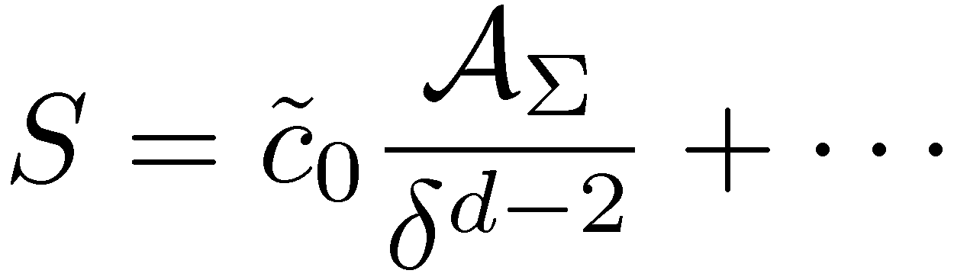
Entanglement Entropy
remaining dof are described by a density matrix
calculate von Neumann entropy:
B
A
R
result is UV divergent! dominated by short-distance correlations
must regulate calculation:
= short-distance cut-off
= spacetime dimension
careful analysis reveals geometric structure, eg,
Notes:
Area law reminds us of black hole entropy (sorkin, srednicki)
Condensed matter physics – used as a diagnostic to characterize quantum phases
Of matter/ also popular in quantum information theory

Slide 9
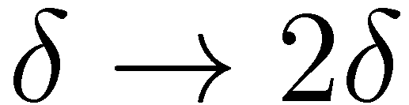
Entanglement Entropy
remaining dof are described by a density matrix
calculate von Neumann entropy:
B
A
R
must regulate calculation:
= short-distance cut-off
= spacetime dimension
leading coefficients sensitive to details of regulator, eg,
find universal information characterizing underlying QFT in
subleading terms, eg,
Notes:
Area law reminds us of black hole entropy (sorkin, srednicki)
Condensed matter physics – used as a diagnostic to characterize quantum phases
Of matter/ also popular in quantum information theory

Slide 10
General comments on Entanglement Entropy:
nonlocal quantity which is (at best) very difficult to measure
no (accepted) experimental procedure
in condensed matter theory: diagnostic to characterize quantum
critical points or topological phases (eg, quantum spin fluids)
in quantum information theory: useful measure of quantum
entanglement (a computational resource)
recently considered in AdS/CFT correspondence
(Ryu & Takayanagi `06)
Notes:
Area law reminds us of black hole entropy (sorkin, srednicki)
Condensed matter physics – used as a diagnostic to characterize quantum phases
Of matter/ also popular in quantum information theory

Slide 11
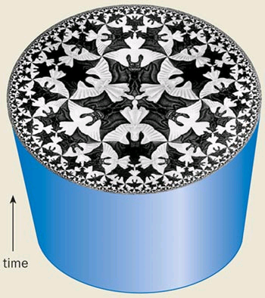
AdS/CFT Correspondence:
Bulk: gravity with negative Λ
in d+1 dimensions
Boundary: quantum field theory
in d dimensions
“holography”
anti-de Sitter
space
conformal
field theory
radius
energy

Slide 12

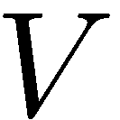
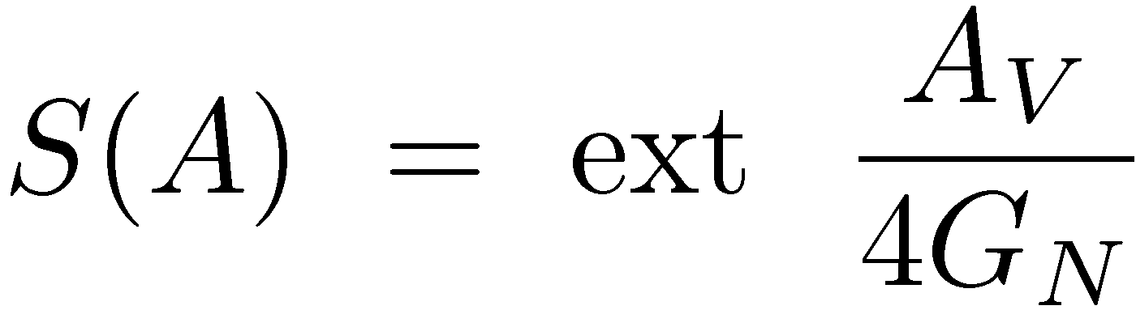



(Ryu & Takayanagi `06)
Holographic Entanglement Entropy:
AdS boundary
B
A
boundary
conformal field
theory
gravitational
potential/redshift
AdS bulk
spacetime
“UV divergence” because area integral extends to

Slide 13
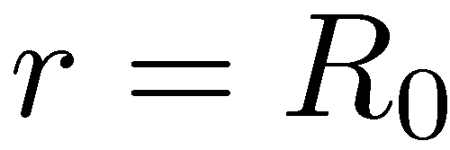
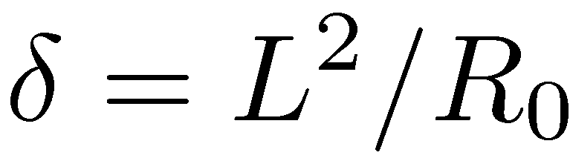
(Ryu & Takayanagi `06)
Holographic Entanglement Entropy:
AdS boundary
B
A
cut-off in boundary CFT:
regulator surface
“UV divergence” because area integral extends to
introduce regulator surface at large radius:
short-distance cut-off in boundary theory:

Slide 14

(Ryu & Takayanagi `06)
Holographic Entanglement Entropy:
AdS boundary
B
A
cut-off in boundary CFT:
cut-off surface
general expression (as desired):
“universal
contributions”
conjecture many detailed consistency tests
(Ryu, Takayanagi, Headrick, Hung, Smolkin, Faulkner, . . . )
proof!! “generalized gravitational entropy”
(Lewkowycz & Maldacena)

Slide 15
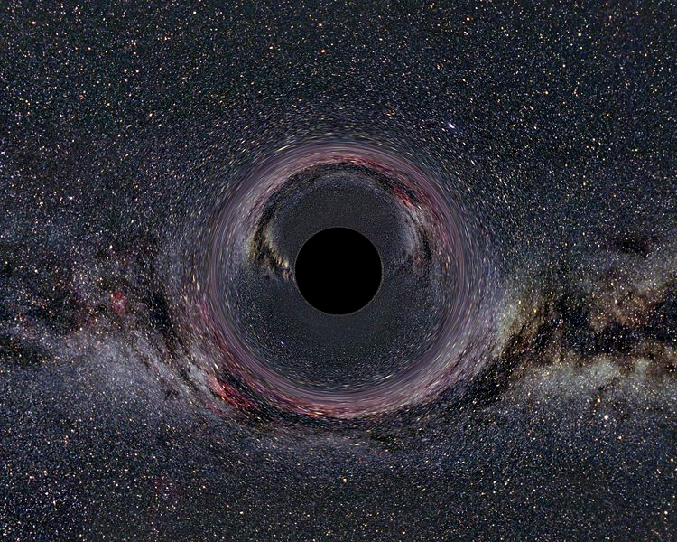
Lessons from Holographic EE:
AdS/CFT Dictionary:
Boundary: thermal plasma
Bulk: black hole
Temperature
Temperature
Energy
Energy
Entropy
Entropy

Slide 16
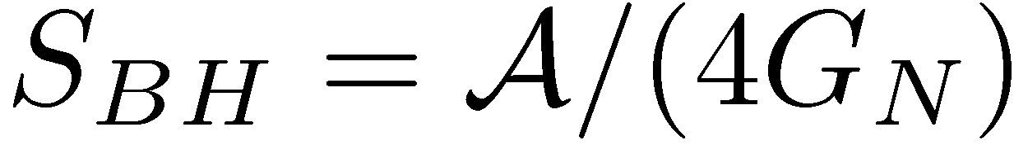
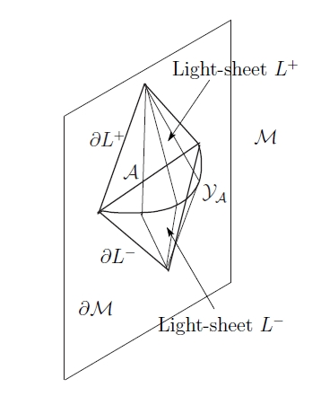

Lessons from Holographic EE:
(entanglement entropy)_{boundary}
= (entropy associated with extremal surface)_{bulk}
R&T construction assigns entropy to bulk
regions with “unconventional” boundaries:
not black hole! not horizon!
not boundary of causal domain!
What are the rules?
extremal
surface
indicates S_{BH} applies more broadly
with our proposal, S_{BH} defines S_{EE}
in bulk gravity for any surface

Slide 17
Lessons from Holographic EE:
(entanglement entropy)_{boundary}
= (entropy associated with extremal surface)_{bulk}
R&T construction assigns entropy to bulk
regions with “unconventional” boundaries:
with our proposal, S_{BH} defines S_{EE} in bulk gravity for any surface
what about extremization?
needed to make match above (in accord with proof)
S_{BH} on other surfaces already speculated to give other entropic
measures of entanglement in boundary theory
entanglement between high and low scales
(Balasubramanian, McDermott & van Raamsdonk)
causal holographic information
(Hubeny & Rangamani; H, R & Tonni; Freivogel & Mosk; Kelly & Wall)
hole-ographic spacetime
(Balasubramanian, Chowdhury, Czech, de Boer & Heller)

Slide 18
Outline:
Introduction and Concluding remarks
  Entanglement Entropy 1:
  ► Basic Definitions
  ► Holographic Entanglement Entropy
Entanglement Entropy 2:
Entanglement Entropy 3:
Entanglement Hamiltonian and Generalizing S_{BH}
5. Randall-Sundrum calculations:
Induced Gravity and Holography
6. Conclusions & Outlook

Slide 19
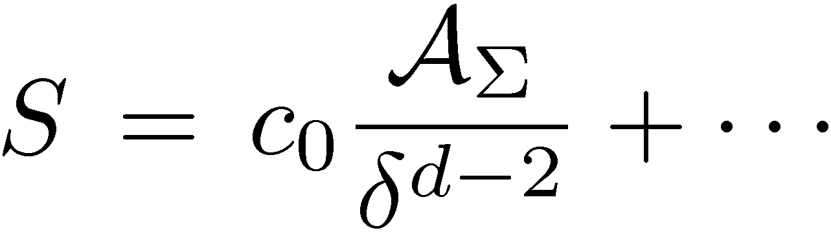
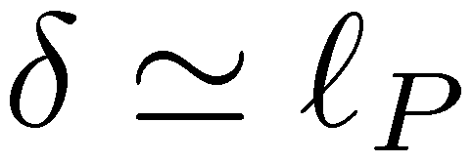
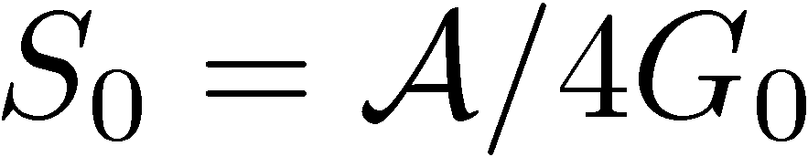
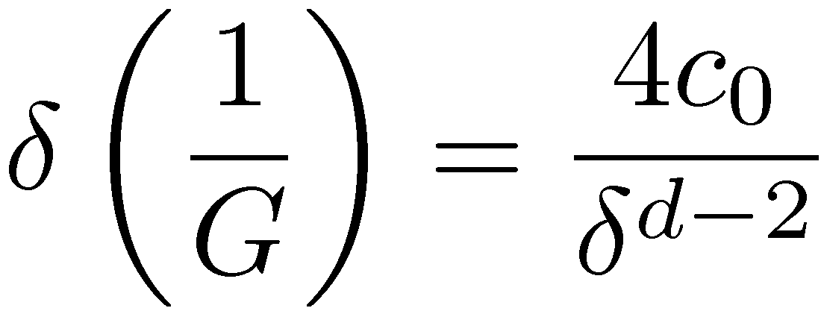

Where did “Entanglement Entropy” come from?:
Sorkin ’84: looking for origin of black hole entropy
recall that leading term obeys “area law”:
suggestive of BH formula if
(Sorkin `84; Bombelli, Koul, Lee & Sorkin; Srednicki; Frolov & Novikov)
problem?: leading singularity not universal; regulator dependent
resolution: this singularity represents contribution of “low energy”
d.o.f. which actually renormalizes “bare” area term
(Susskind & Uglum)
both coefficients are regulator dependent
but for a given regulator should match!
Notes:
Area law reminds us of black hole entropy (sorkin, srednicki)
Condensed matter physics – used as a diagnostic to characterize quantum phases
Of matter/ also popular in quantum information theory

Slide 20
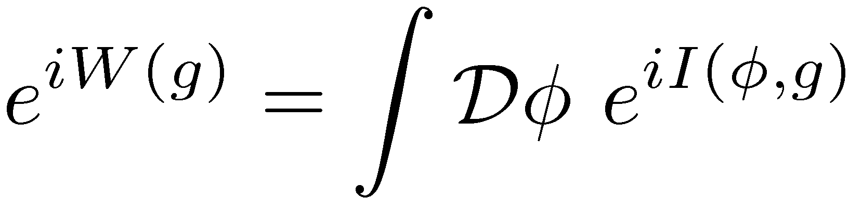
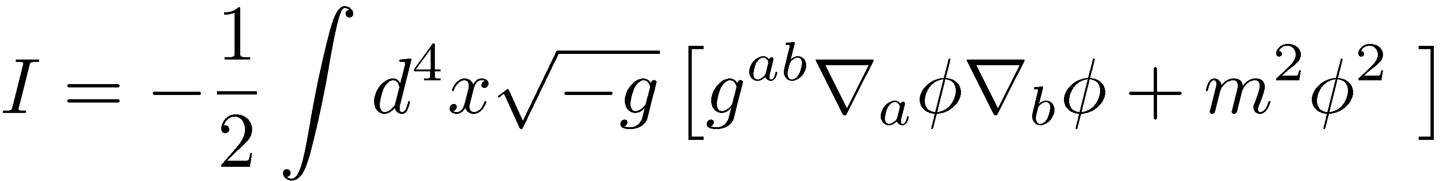
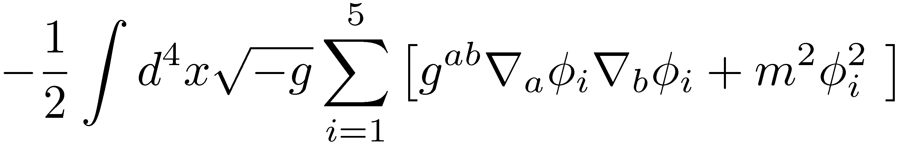
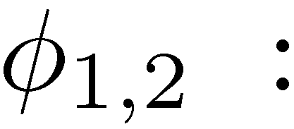
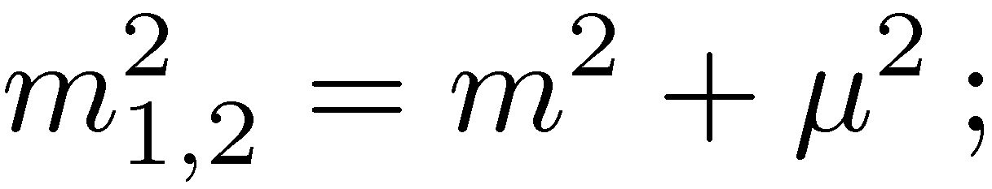
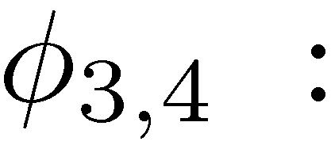
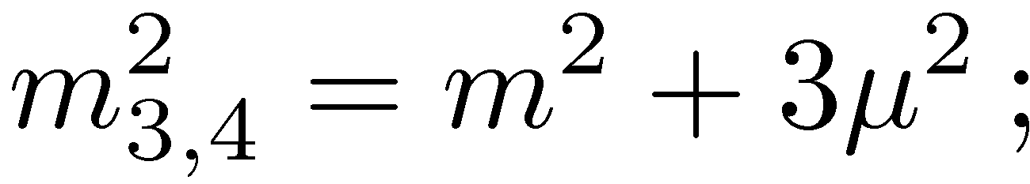
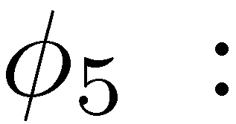
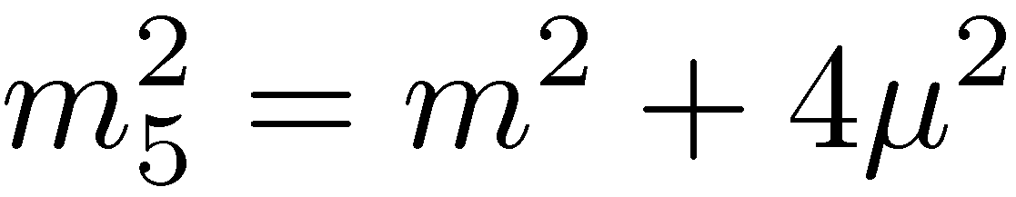
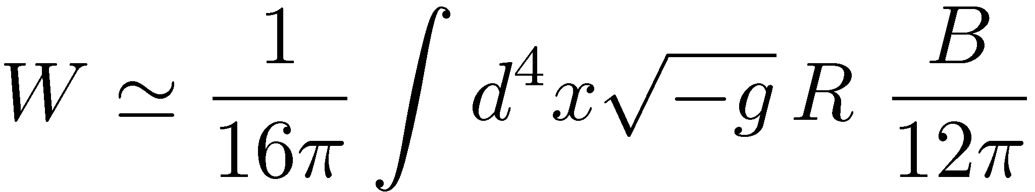
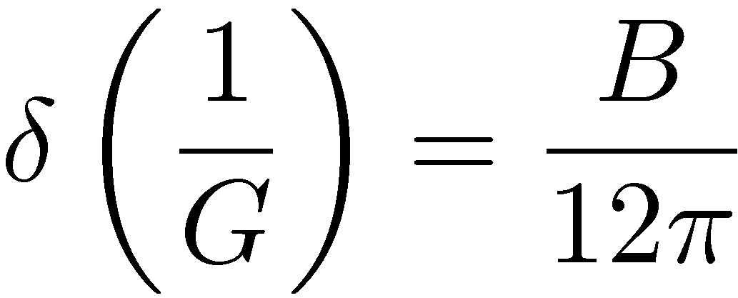
BH Entropy ~ Entanglement Entropy
(Demers, Lafrance & Myers)
massive d=4 scalar: integrating out yields effective metric action
with
must regulate to control UV divergences in W(g)
Pauli-Villars fields:
anti-commuting,
commuting,
anti-commuting,
UV regulator scale
effective Einstein term:
with
quadratic
divergence
renormalization of Newton’s constant:

Slide 21
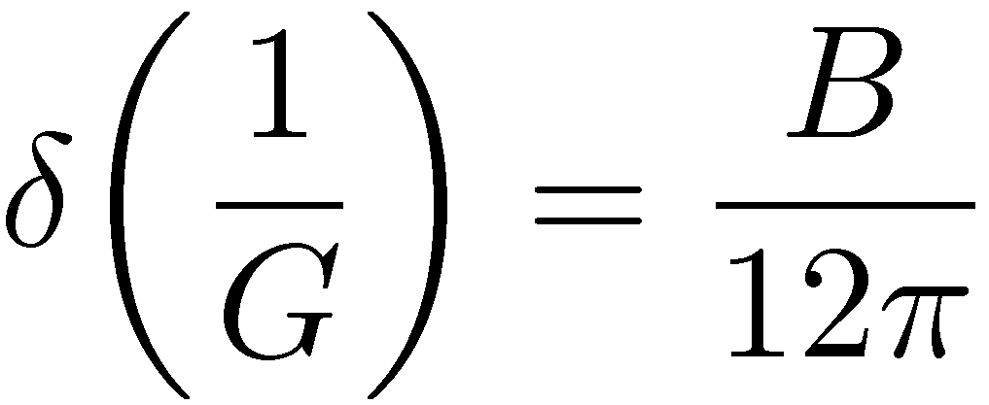
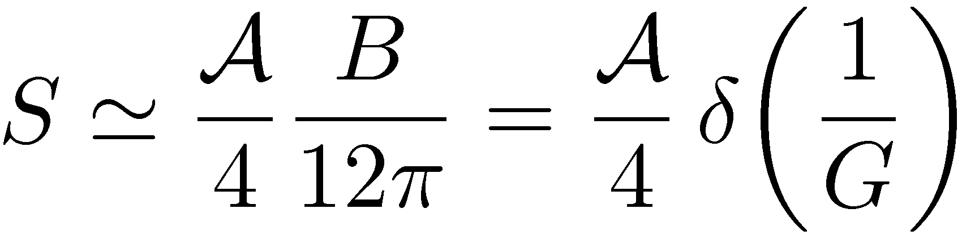
BH Entropy ~ Entanglement Entropy
(Demers, Lafrance & Myers)
massive d=4 scalar: integrating out yields effective action W(g)
effective Einstein term:
with
quadratic
divergence
renormalization of Newton’s constant:
scalar field contribution to BH entropy:
extends to log divergence; matches curvature correction to S_{Wald}

Slide 22


BH Entropy ~ Entanglement Entropy
(Susskind & Uglum)
both coefficients are regulator dependent
but for a given regulator should match!
“a beautiful idea killed by ugly calculations”??
seemed matching was not always working??
numerical factors resolved; extra boundary terms interpeted
(Fursaev, Solodukhin, Miele, Iellici, Moretti, Donnelly, Wall . . . )
(Cooperman & Luty)
matching of area term works for any QFT (s=0,1/2, 1, 3/2)
to all orders in perturbation theory for any Killing horizon
technical difficulties for spin-2 graviton
♥
results apply for Rindler horizon in flat space
conceptual/technical issues may remain
(Jacobson & Satz; Solodukhin)

Slide 23
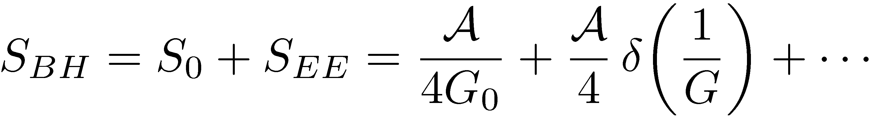
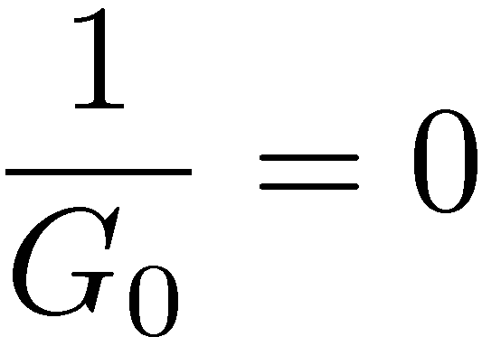
BH Entropy ~ Entanglement Entropy
(Susskind & Uglum)
both coefficients are regulator dependent
but for a given regulator should match!
“a beautiful killed by ugly facts”??
result “unsatisfying”:
where did bare term come from?
consider “induced gravity”:
(Jacobson; Frolov, Fursaev & Solodukhin)
formally “off-shell” method is precisely calculation of S_{EE}
(Susskind & Uglum; Callan & Wilczek; Myers & Sinha: extends to S_{wald})
challenge: understand microscopic d.o.f. of quantum gravity
AdS/CFT: eternal black hole (or any Killing horizon)
(Maldacena; van Raamsdonk et al; Casini, Huerta & Myers)

Slide 24
Outline:
Introduction and Concluding remarks
  Entanglement Entropy 1:
  ► Basic Definitions
  ► Holographic Entanglement Entropy
Entanglement Entropy 2:
Entanglement Entropy 3:
Entanglement Hamiltonian and Generalizing S_{BH}
5. Randall-Sundrum calculations:
Induced Gravity and Holography
6. Conclusions & Outlook

Slide 25


Entanglement Hamiltonian:
B
A
first step in calculation of S_{EE} is to determine
reproduces standard correlators, eg, if global vacuum:
by causality, describes physics throughout causal domain

Slide 26
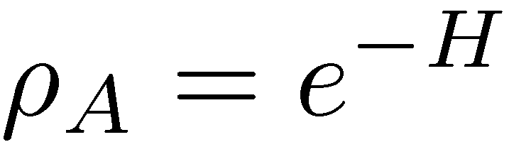

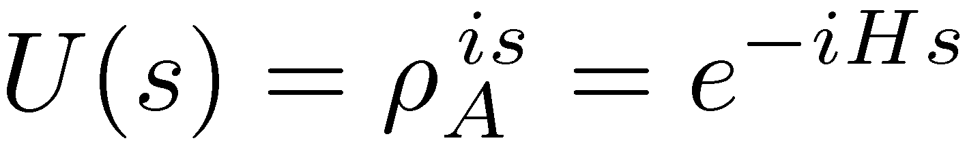
Entanglement Hamiltonian:
B
A
hermitian and positive semi-definite, hence
= modular or entanglement Hamiltonian
formally can consider evolution by
unfortunately is nonlocal and flow is nonlocal/not geometric

Slide 27

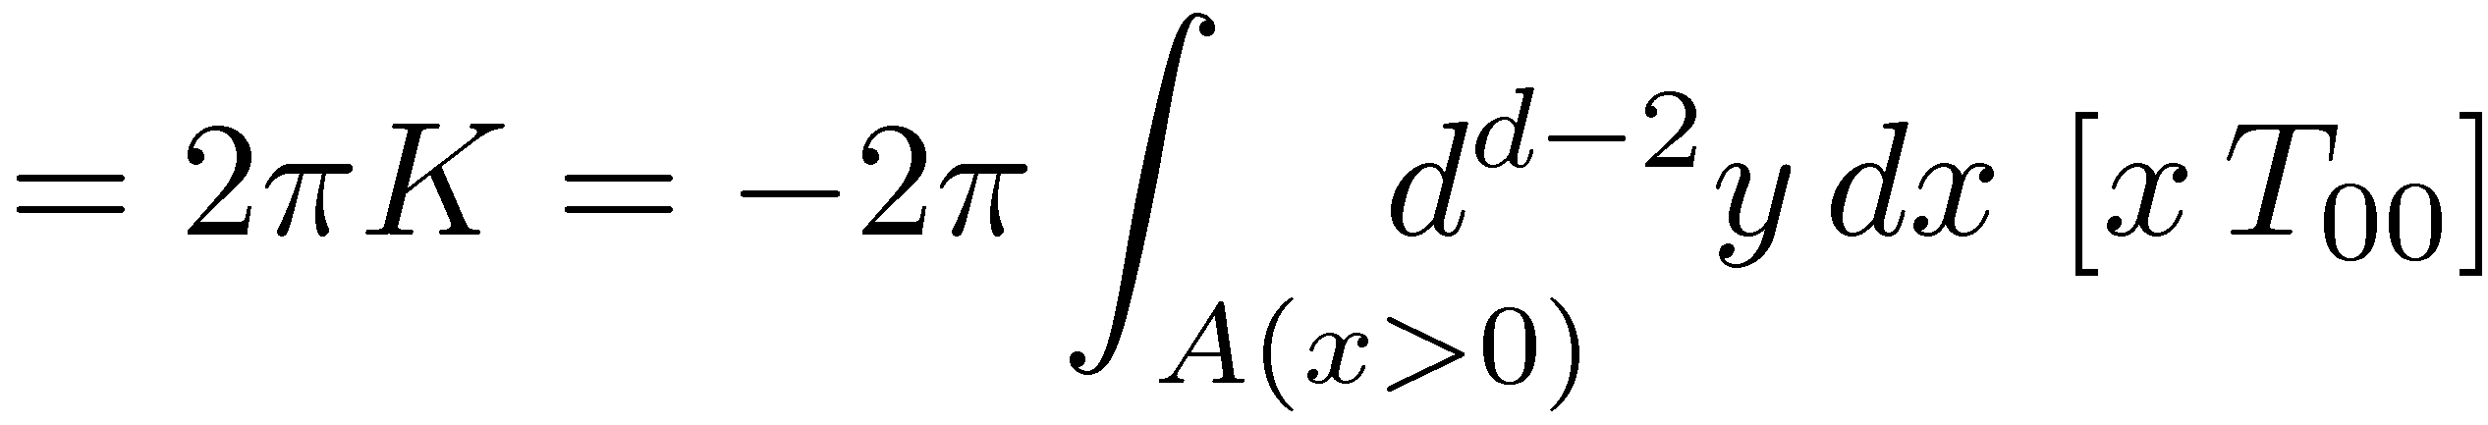
Entanglement Hamiltonian:
B
A
hermitian and positive semi-definite, hence
= modular or entanglement Hamiltonian
explicitly known only in limited examples
most famous example: Rindler wedge
boost generator
B
●
A
Notes:
CFT in a spherical region; 2d CFT on rindler wedge at finite temperature

Slide 28
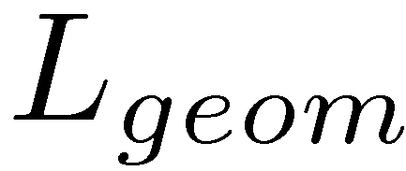
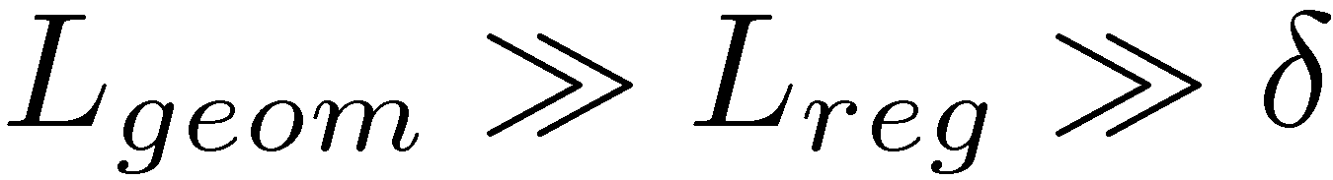
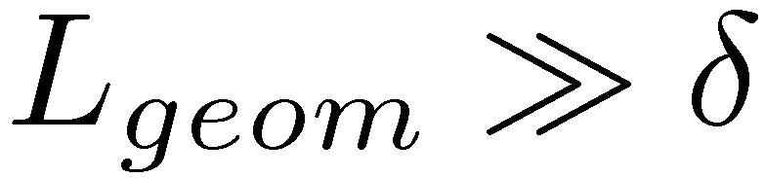
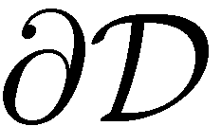



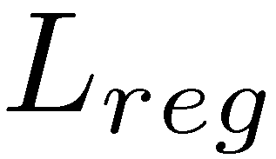

Entanglement Hamiltonian:
Can this formalism provide
insight for “area law” term in S_{EE}?
A
zoom in on infinitesimal patch of
region looks like flat space
looks like Rindler horizon
assume Hadamard-like state
correlators have standard UV sing’s
UV part of same as in flat space
must have Rindler term:

Slide 29
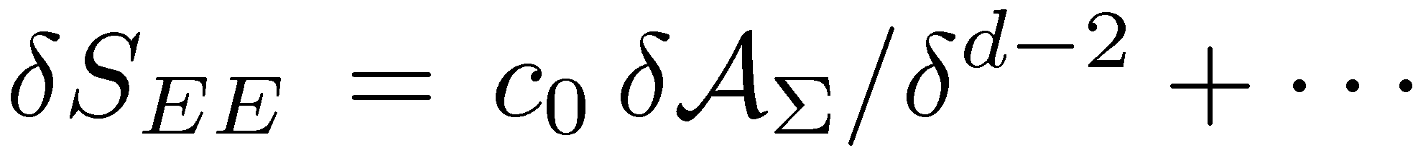


Entanglement Hamiltonian:
Can this formalism provide
insight for “area law” term in S_{EE}?
for each infinitesimal patch:
A
UV part of must be
same as in flat space
must have Rindler term:
Rindler yields area law; hence
hence S_{EE} must contain divergent area law contribution!
invoke Cooperman & Luty: area law divergence matches
precisely renormalization of :
for any large region of smooth geometry!!

Slide 30
Entanglement Hamiltonian:
Can this formalism provide
insight for “area law” term in S_{EE}?
A
Cooperman & Luty: area law divergence
matches precisely renormalization of :
for any large region of smooth geometry!!
consistency check of new proposal but
where did bare term come from?

Slide 31



Entanglement Hamiltonian:
where did bare term come from?
formally can apply standard geometric arguments in Rindler
patches, analogous to the “off-shell” calc’s for black holes
entanglement Hamiltonian not “mysterious” with Killing symmetry
eg, Killing horizons: Rindler, de Sitter, stationary black holes, . . .
(see also: Wong, Klich, Pando Zayas & Vaman)
carry QFT discussion over to geometric discussion:
- zooming in on entangling surface restores “rotational” symmetry
- can apply standard geometric arguments to find bndry terms
spherical entangling surface in flat space
(Balasubramanian, Czech, Chowdhury & de Boer)

Slide 32


Entanglement Hamiltonian:
where did bare term come from?
consider gravitational action with higher order corrections:
apply new technology: “Distributional Geometry of Squashed Cones”
(Fursaev, Patrushev & Solodukhin)
compare to Wald entropy for such higher curvature actions:
in general, S_{EE} and S_{Wald} differ (beyond area law) by extrinsic
curvature terms but will agree on stationary event horizon

Slide 33
Entanglement Hamiltonian:
where did bare term come from?
challenge: understand “bare term” from perspective of
microscopic d.o.f. of quantum gravity

Slide 34
Outline:
Introduction and Concluding remarks
  Entanglement Entropy 1:
  ► Basic Definitions
  ► Holographic Entanglement Entropy
Entanglement Entropy 2:
Entanglement Entropy 3:
Entanglement Hamiltonian and Generalizing S_{BH}
5. Randall-Sundrum calculations:
Induced Gravity and Holography
6. Conclusions & Outlook

Slide 35


5) Randall-Sundrum 2 model
AdS/CFT cut-off surface becomes a physical brane
graviton zero-mode becomes normalizable
D=d+1 AdS gravity (with cut-off) + brane matter
d-dim. CFT (with cut-off) + d-dim. gravity + brane matter
induced gravity: “boundary divergences” become effective action
on-shell
cancel with
brane tension
CFT
correlators
boundary gravity

Slide 36





5) Randall-Sundrum 2 model
AdS/CFT cut-off surface becomes a physical brane
graviton zero-mode becomes normalizable
D=d+1 AdS gravity (with cut-off) + brane matter
d-dim. CFT (with cut-off) + d-dim. gravity + brane matter
induced gravity: “boundary divergences” become effective action
AdS scale, L = short-distance cut-off in CFT
fundamental parameters: cut-off scale in CFT
CFT central charge (# dof)
only leading contributions in an expansion of large !!

Slide 37

5) Randall-Sundrum 2 model
(Fursaev; Emparan)
entanglement entropy calculated with R&T prescription
for BH’s on brane, horizon entropy = entanglement entropy
(see also: Hawking, Maldacena & Strominger; Iwashita et al)
entanglement entropy for any macroscopic region is finite in
a smooth boundary geometry:
(Pourhasan, Smolkin & RM)
!!!
B
A
brane regulates all entanglement entropies!!

Slide 38

5) Randall-Sundrum 2 model
(Pourhasan, Smolkin & RM)
consider boundary gravitational action to higher orders:
using models with Einstein and GB gravity in bulk
careful analysis of asymptotic geometry yields
complete agreement with previous geometric calculation!!

Slide 39

Entanglement Hamiltonian:
where did bare term come from?
consider gravitational action with higher order corrections:
apply new technology: “Distributional Geometry of Squashed Cones”
(Fursaev, Patrushev & Solodukhin)
compare to Wald entropy for such higher curvature actions:
in general, S_{EE} and S_{Wald} differ (beyond area law) by extrinsic
curvature terms but will agree on stationary event horizon

Slide 40
5) Randall-Sundrum 2 model
(Pourhasan, Smolkin & RM)
consider boundary gravitational action to higher orders:
using models with Einstein and GB gravity in bulk
careful analysis of asymptotic geometry yields
complete agreement with previous geometric calculation!!
again, S_{EE} and S_{Wald} agree up to extrinsic curvature terms
supports idea that new results calculate entanglement entropy

Slide 41




5) Randall-Sundrum 2 model
(with Pourhasan & Smolkin)
consider entanglement entropy of “slab” geometry in flat space:
H
test corrections
B
B
define:
A
Lorentz inv, unitarity &
subadditivity:
H
(Casini & Huerta; Myers & Singh)

Slide 42

5) Randall-Sundrum 2 model
(with Pourhasan & Smolkin)

Slide 43

5) Randall-Sundrum 2 model
(with Pourhasan & Smolkin)

Slide 44







5) Randall-Sundrum 2 model
(with Pourhasan & Smolkin)
Lorentz inv, unitarity & subadditivity:
X
inequality breaks down when
higher curvature & nonlocal
effects important; slab not
resolved; subadditivity lost
(similar test with cylinders)

Slide 45
Outline:
Introduction and Concluding remarks
  Entanglement Entropy 1:
  ► Basic Definitions
  ► Holographic Entanglement Entropy
Entanglement Entropy 2:
Entanglement Entropy 3:
Entanglement Hamiltonian and Generalizing S_{BH}
5. Randall-Sundrum calculations:
Induced Gravity and Holography
6. Conclusions & Outlook

Slide 46



Conclusions:
proposal: in quantum gravity, for any sufficiently large region in
a smooth background, there is a finite entanglement entropy
which takes the form:
B
Σ
A
five lines of evidence: 1) holographic entanglement entropy,
2) QFT renormalization of , 3) induced gravity models,
4) Jacobson’s arguments and 5) spin-foam models

Slide 47
FAQ: 1) Why should I care?
After all entanglement entropy is not a measurable quantity?
not yet! it remains an interesting question to find physical
processes are governed by entanglement entropy
eg, production of charged black holes in bkgd field;
(Garfinkle, Giddings & Strominger)
Renyi entropy & tunneling between spin chain states
(Abanin & Demler)
compare to quantum many body physics:
(Popescu, Short & Winter)
generic states do not satisfy “area law” but low energy states do
locality of the underlying Hamiltonian restricts the
entanglement of the microscopic constituents
tensor network program
Lesson(s) for quantum gravity?

Slide 48
FAQ: 2) Why should I care?
“Smooth curvatures are a signature of macroscopic spacetime”
seems a simpler/better/more intuitive slogan.
this proposal relates (semi)classical geometry directly to a
property of the underlying quantum description
“in QG, short-range quantum entanglement points
towards how microscopic dof build up a
macroscopic spacetime geometry”

Slide 49
FAQ: 3) Why should I care?
The area of a finite region can not possibly be an
observable in quantum gravity!
question of observables in QG has a long history; do not have
a solution here but suggestion towards a construction
in spacetime with boundary, use
light sheets to connect entangling
surface to boundary and define
with corresponding boundary data
Σ
compare with “hole-ographic spacetime”

Slide 50


(Balasubramanian, Chowdhury, Czech, de Boer & Heller)
“hole-ographic spacetime”:
calculate “gravitational entropy” of curves inside of d=3 AdS
space, in terms of entropies of bounded regions in boundary
“residual entropy”: maximum entropy of a density
matrix describing all measurements
of finite-time local observers

Slide 51
Conclusions:
proposal: in quantum gravity, for any sufficiently large region in
a smooth background, there is a finite entanglement entropy
which takes the form:
future directions:
► find interesting string framework to calculate
► find connection to “generalized gravitational entropy”
► better understand higher curvature corrections
► does entropy have an operational meaning?
► further develop spin-foam calculations
► avoid being scrambled by any firewalls!

