Slide 1


Notes:
1

Slide 2





Notes:
2

Slide 3






Notes:
3

Slide 4



Notes:
4

Slide 5









Notes:
5

Slide 6
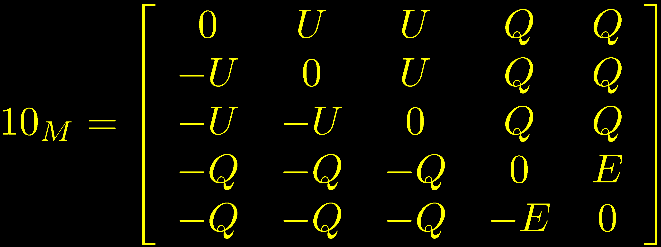
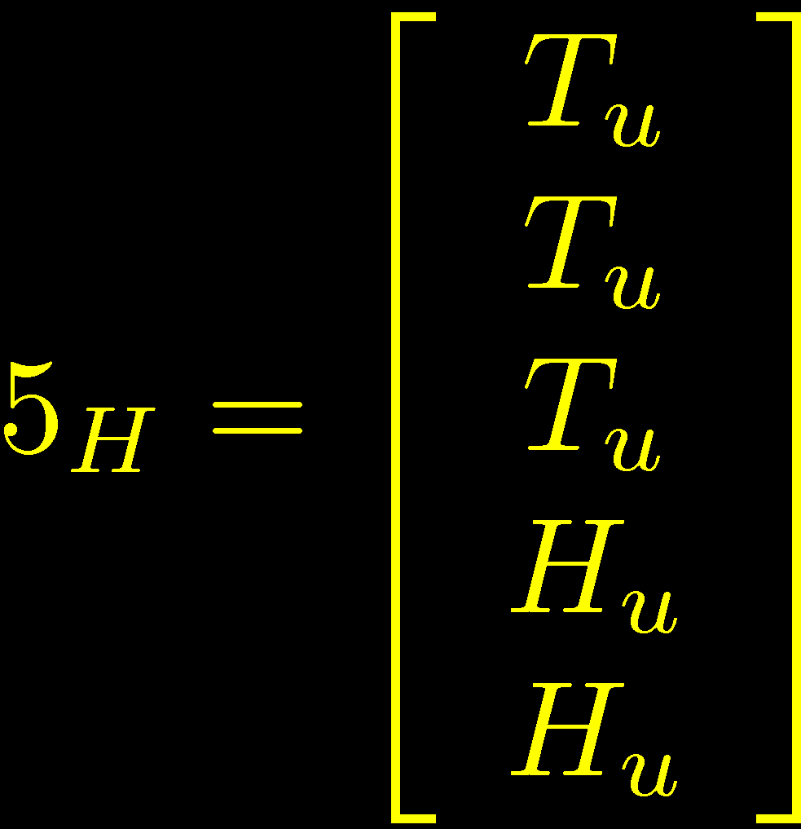

Notes:
6

Slide 7





Notes:
7

Slide 8



Notes:
8

Slide 9






Aldazabal Ibanez
Quevedo Uranga ’00
Verlinde Wijnholt ’05
+ many others
Notes:
9

Slide 10
Notes:
10

Slide 11

Notes:
11

Slide 12

Notes:
12

Slide 13







Vafa ‘96
Notes:
13

Slide 14
















Notes:
14

Slide 15











Notes:
15

Slide 16


Notes:
16

Slide 17





Notes:
17

Slide 18








Notes:
18

Slide 19



Notes:
19

Slide 20

Notes:
20

Slide 21














Notes:
21

Slide 22





Notes:
22

Slide 23







Notes:
23

Slide 24

Notes:
24

Slide 25
Notes:
25

Slide 26
Notes:
26

Slide 27




Notes:
27

Slide 28

Notes:
28

Slide 29







Notes:
29

Slide 30






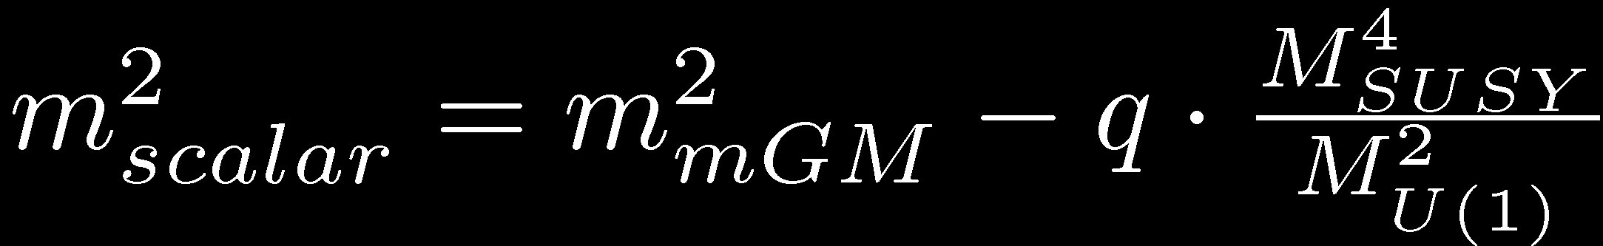
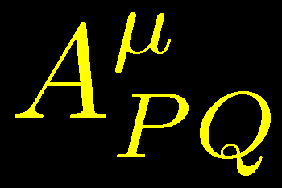

Notes:
30

Slide 31





Notes:
31

Slide 32





Notes:
32

Slide 33

Notes:
33

Slide 34


Notes:
34

Slide 35


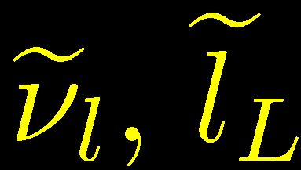




Slide 36



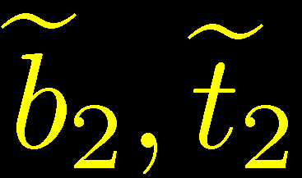











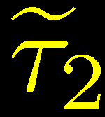






Notes:
36

Slide 37



















Notes:
37

Slide 38
Notes:
38

Slide 39




Slide 40



Slide 41







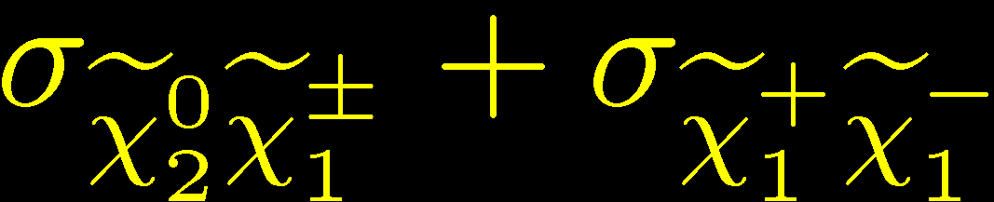
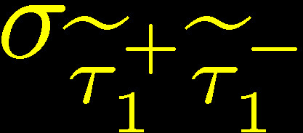

Slide 42




Slide 43



Slide 44










Slide 45




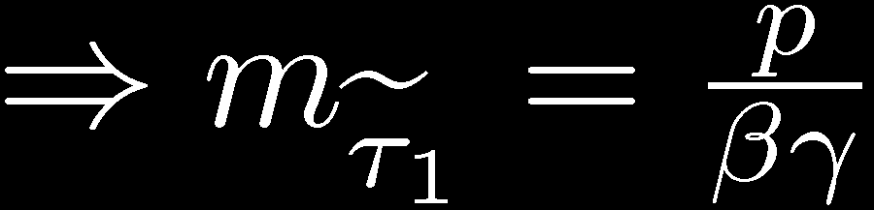


c.f. Martin Wells ’97,
Hinchliffe Paige ’98,
Ambrosiano et al. ’00
Ellis et al. ’06, Ibe Kitano ’07
ATLAS TDR, CMS TDR,…

Slide 46


(smearing as in Ambrosiano et al. ’00)

Slide 47



(c.f. Ambrosiano
et al. ’00)

Slide 48




Slide 49



Slide 51









Slide 52









Slide 53





Slide 54

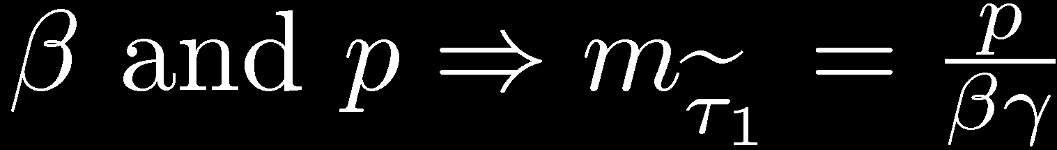


Hinchliffe Paige ’98 Ellis et al. ’06
Ibe Kitano ’07 Ito Kitano Moroi ’09
Ellis et al. ’06

Slide 55











Buchmuller et al. ’04
Feng and Smith ’04
De Roeck et al. ’05
Hamaguchi et al. ’04, ’06, ’09

Slide 56



Slide 57




Notes:
57

